Slide 1


First Responders Tracker
5G Tracking Inside-Out
Project Proposal By The Future Penguin
Dale Graham | dale.graham@my.utsa.edu
Jina Wilde | jina.wilde@my.utsa.edu
Raisul Islam | raisul.islam@utsa.edu
Samantha Ramos | samantha.ramos@my.utsa.edu

Slide 2
Outline
Introduction to the Problem & Proposed Solution
5G Architecture Overview
Sensors Technologies
GUI Application
Future Work
Conclusion

Slide 3
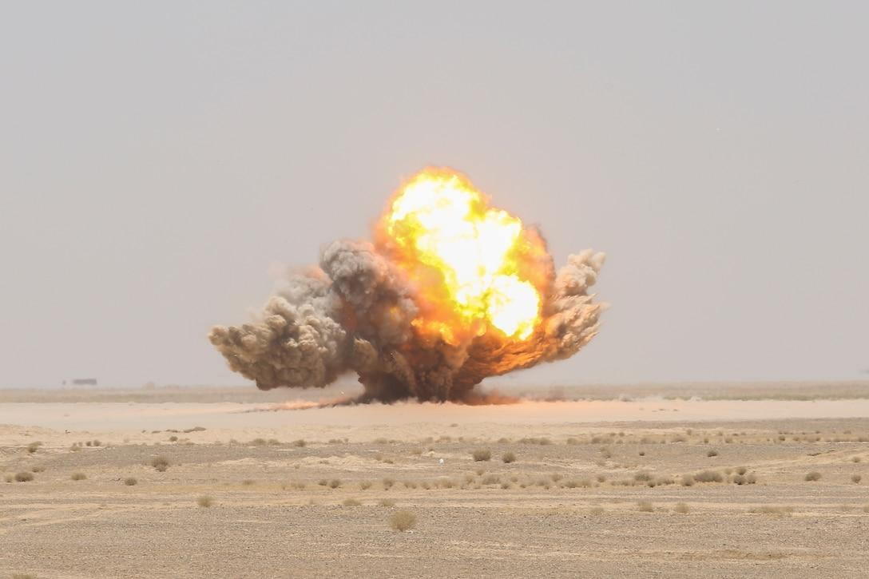
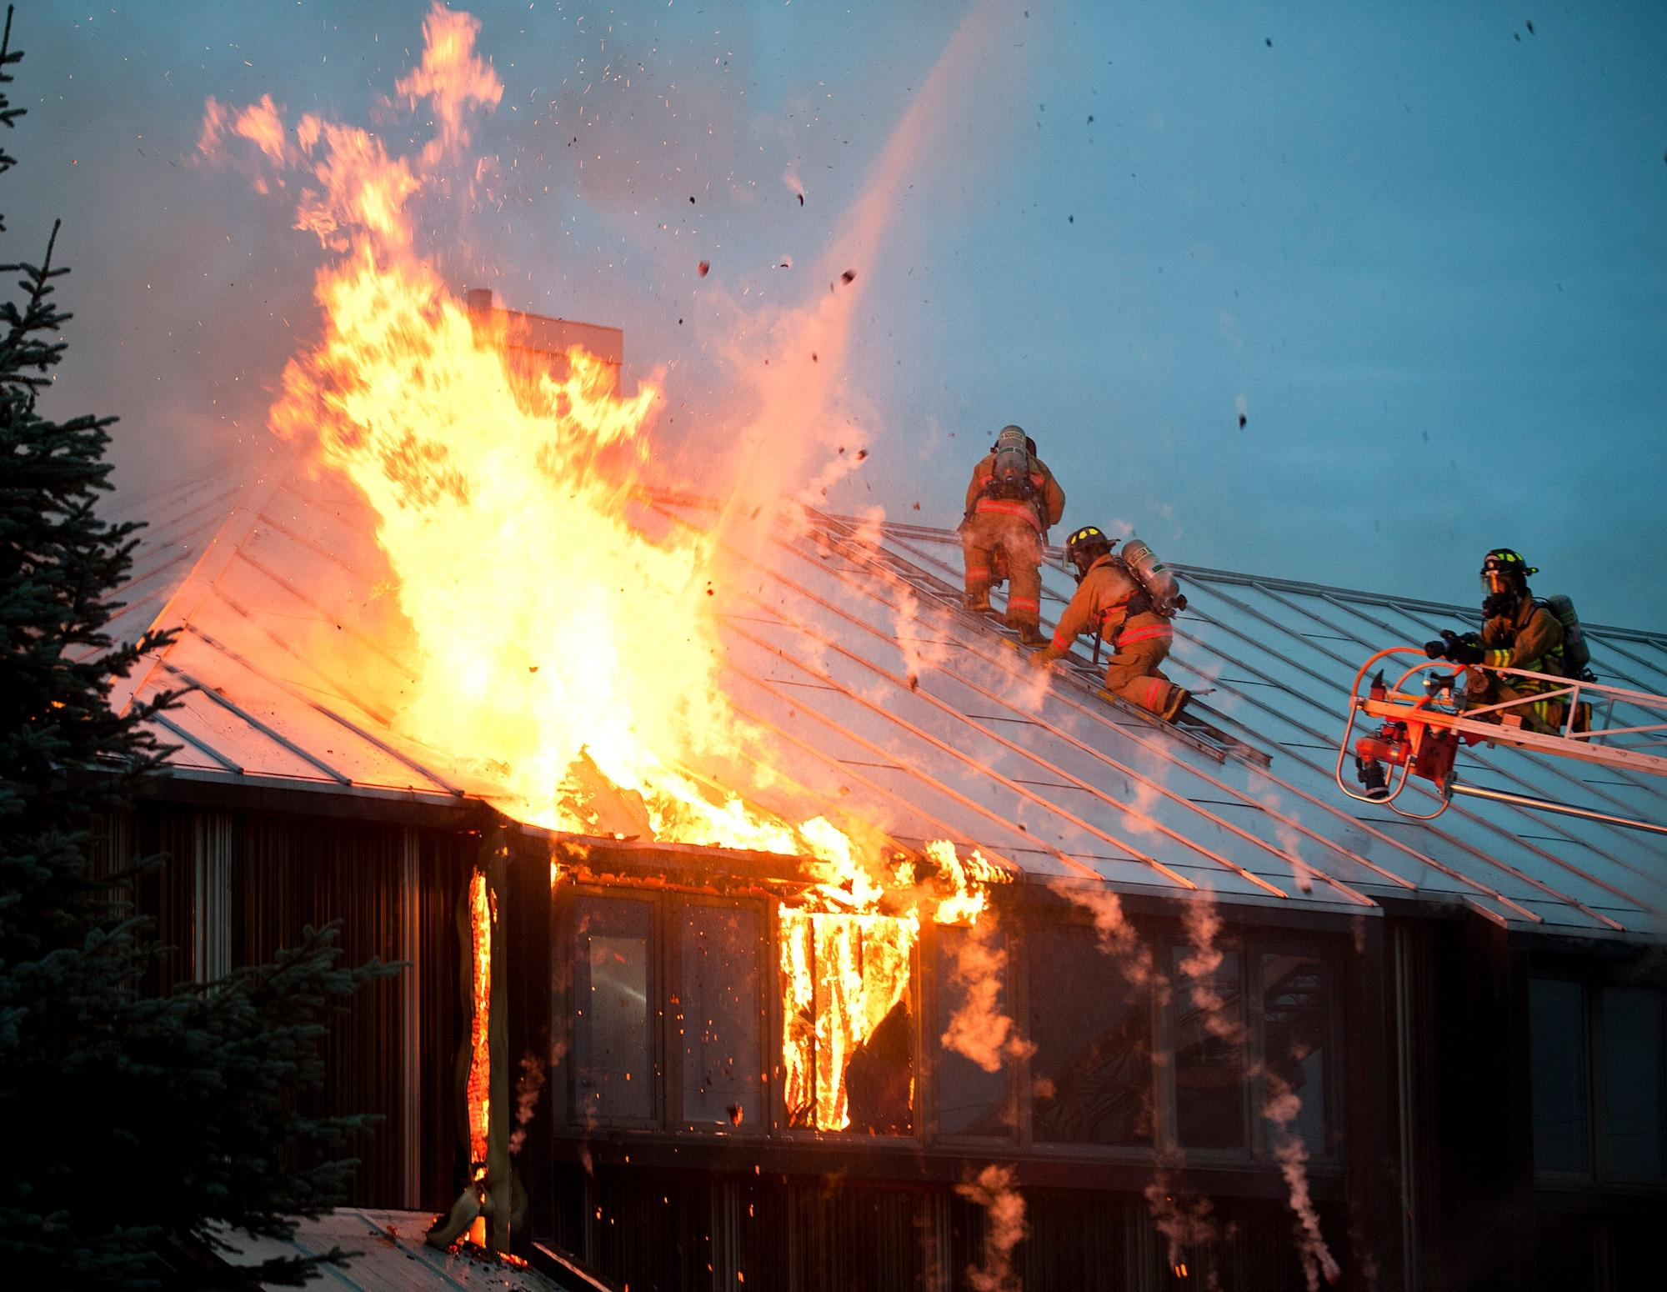
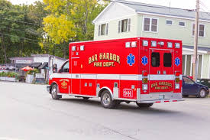
Introduction to the Problem
First responders have difficulty seeing in some situations or finding and locating hazardous materials such as bombs and land mines. 5G technology will assess the scene before, during and after emergency events to assist first responders with real-time data, communications and tools.
Before going into buildings on fire, for example, temperature sensors, carbon monoxide and smoke detectors, and cameras can transmit data to see what is happening. If the ceiling is collapsing or the air is not breathable, first responders can make better decisions.
During the emergency events, location signals and sensor data can be relayed in real-time to keep track of their movements and environment.
After the event, first responders will be able to get additional information such as traffic conditions for ambulances to get to the hospital.
The tracking system will have features that can also be deployed for military use.
Notes:
Jina, Samantha, Raisul

Slide 4
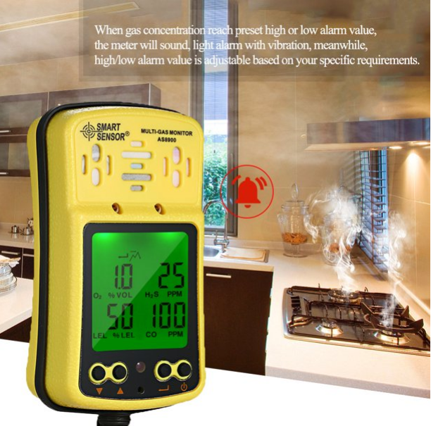
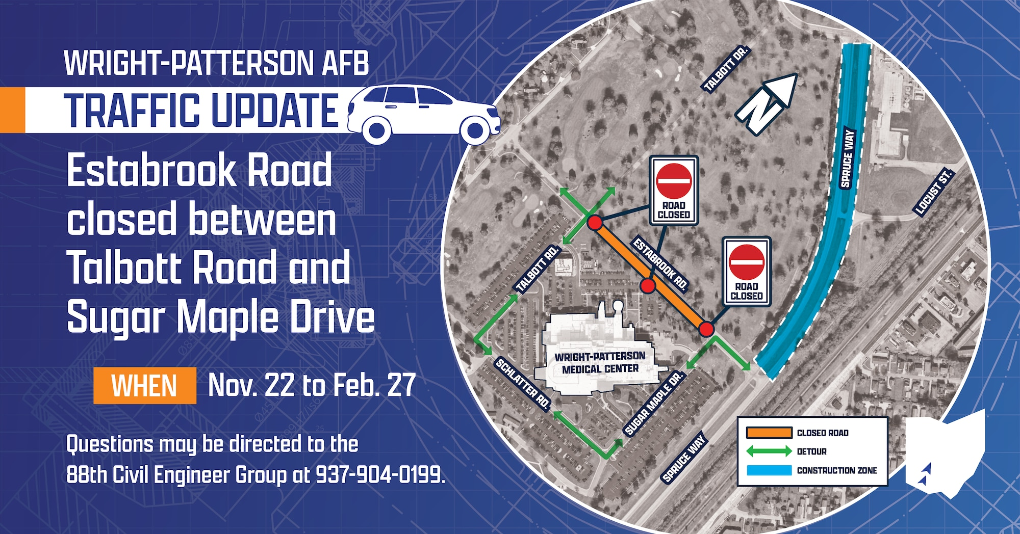
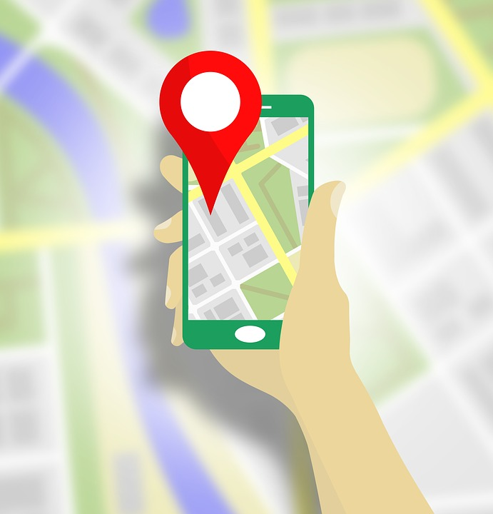
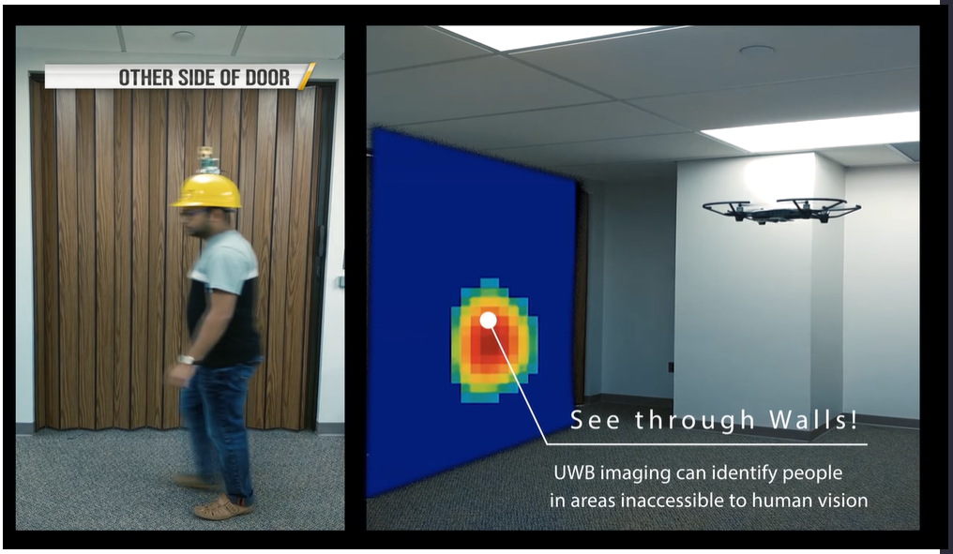
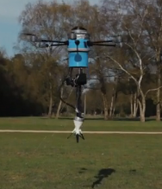
First Responder Tracker Solution & Features
The solution will be the First Responder Tracker system. 5G technology will enable faster data transmission from sensors, cameras, and detection devices for real-time analytics and better decision-making.
The market segment targets will be the federal government with the National Guard and military, and local governments with first responders.Monetization will focus on these target audiences.
Features will include mobile apps with multi-gas sensor detection readings, mapping indoors with thermal viewing, real-time traffic updates, and even landmine detection.
Notes:
Jina,

Slide 5
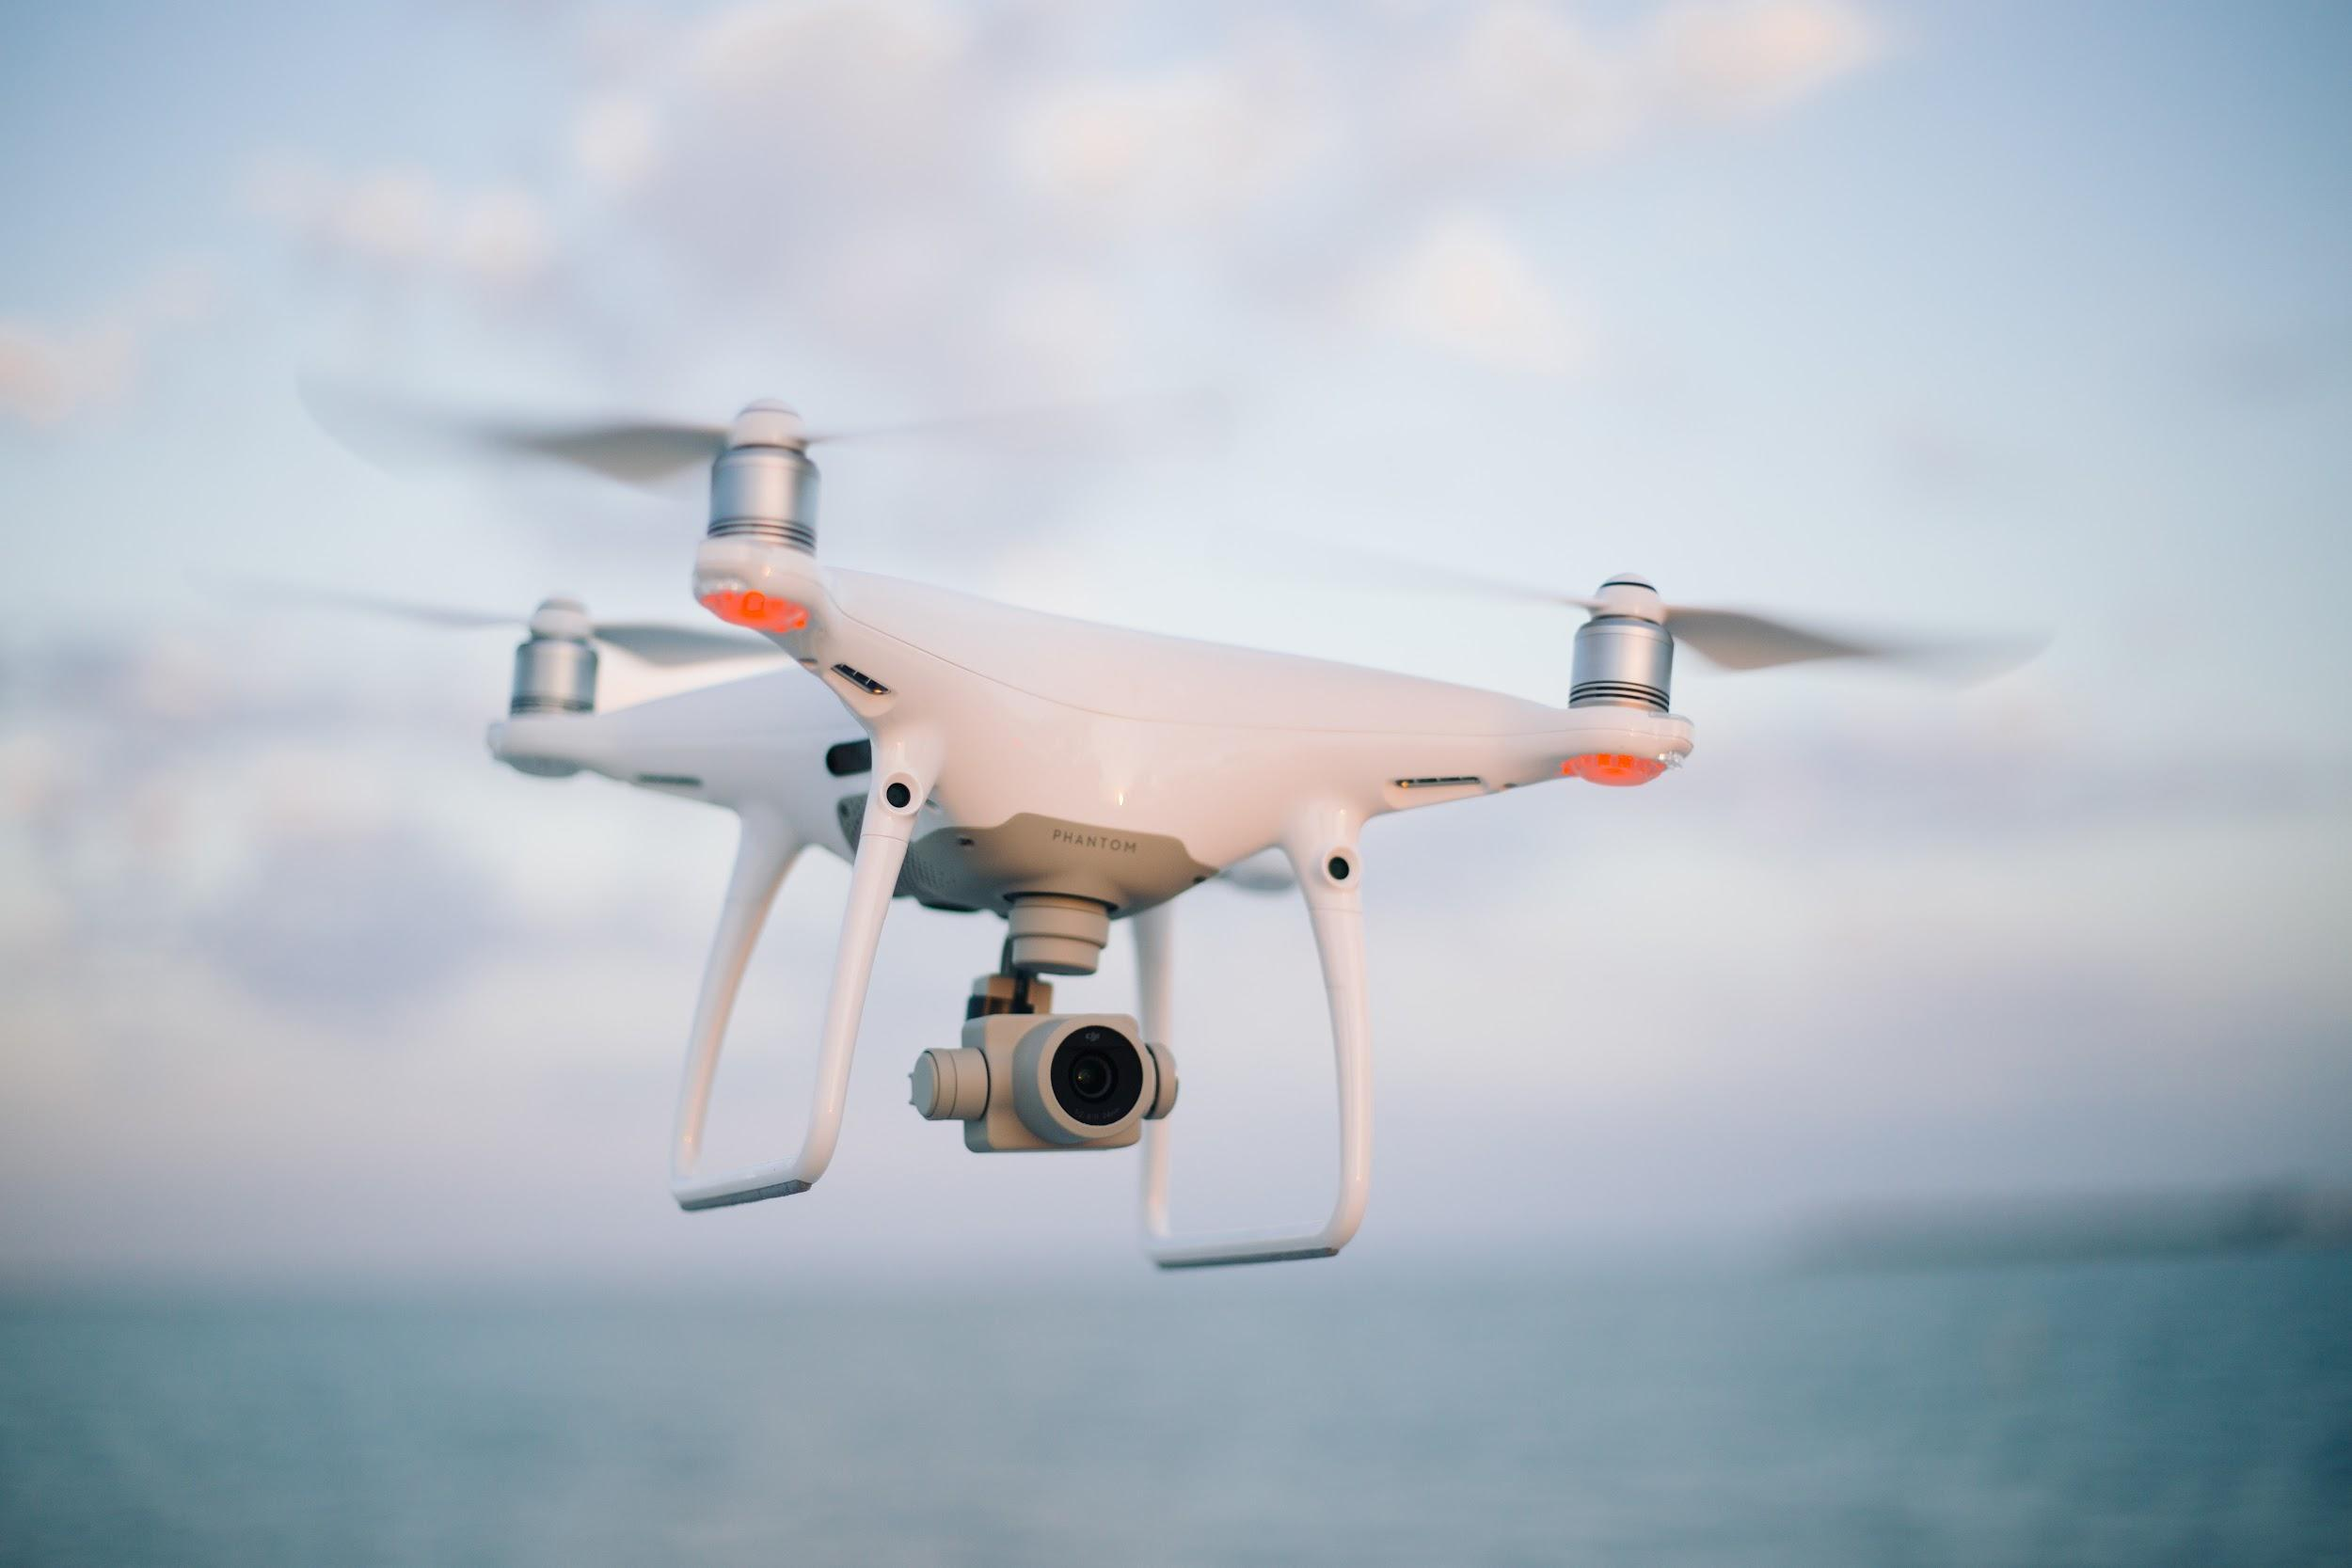
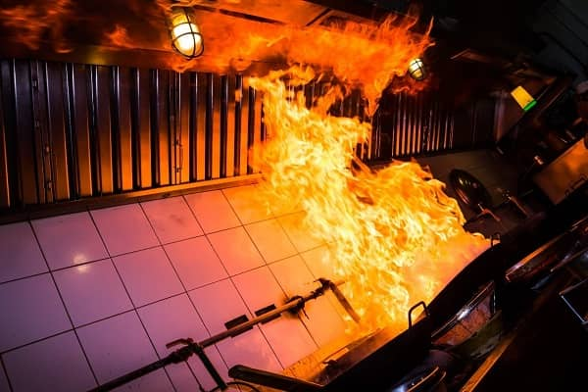
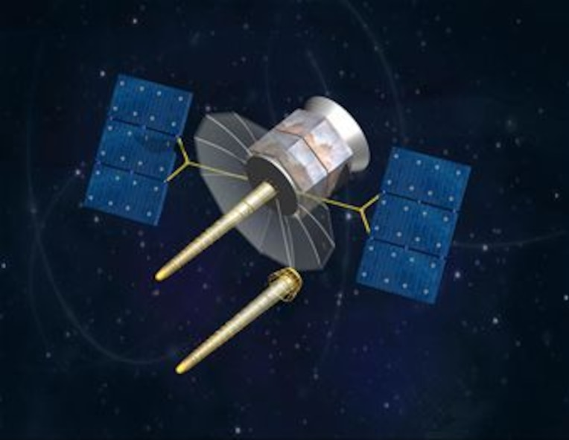
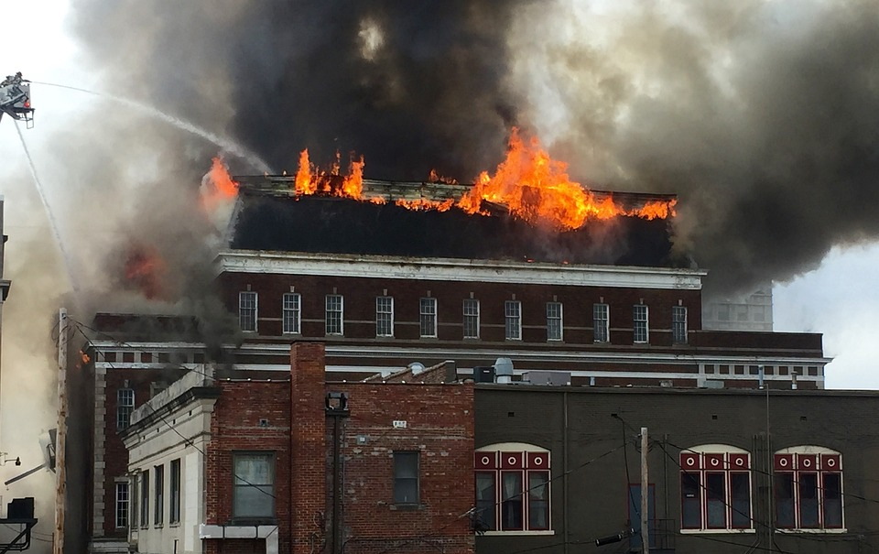
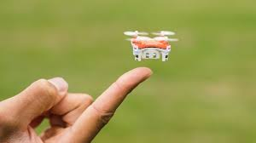
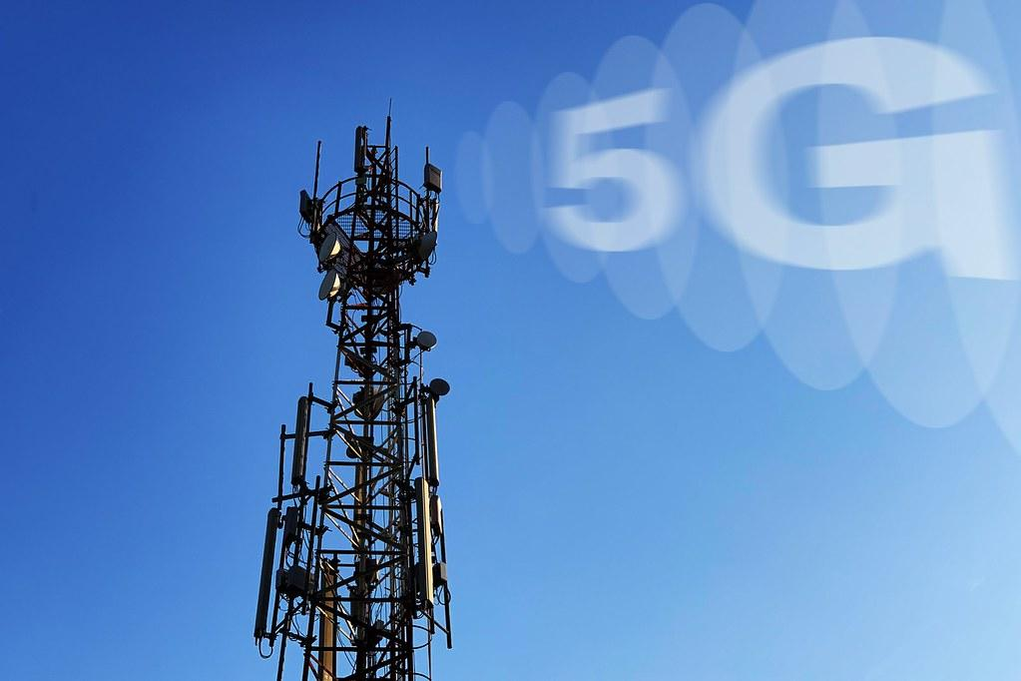
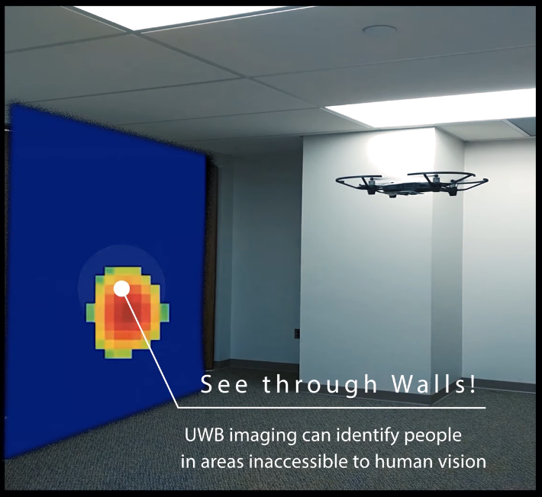
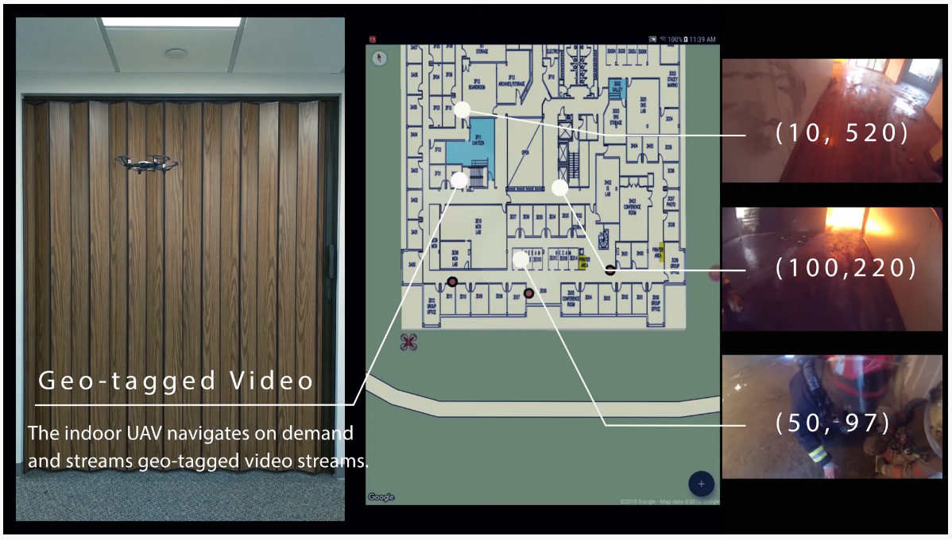
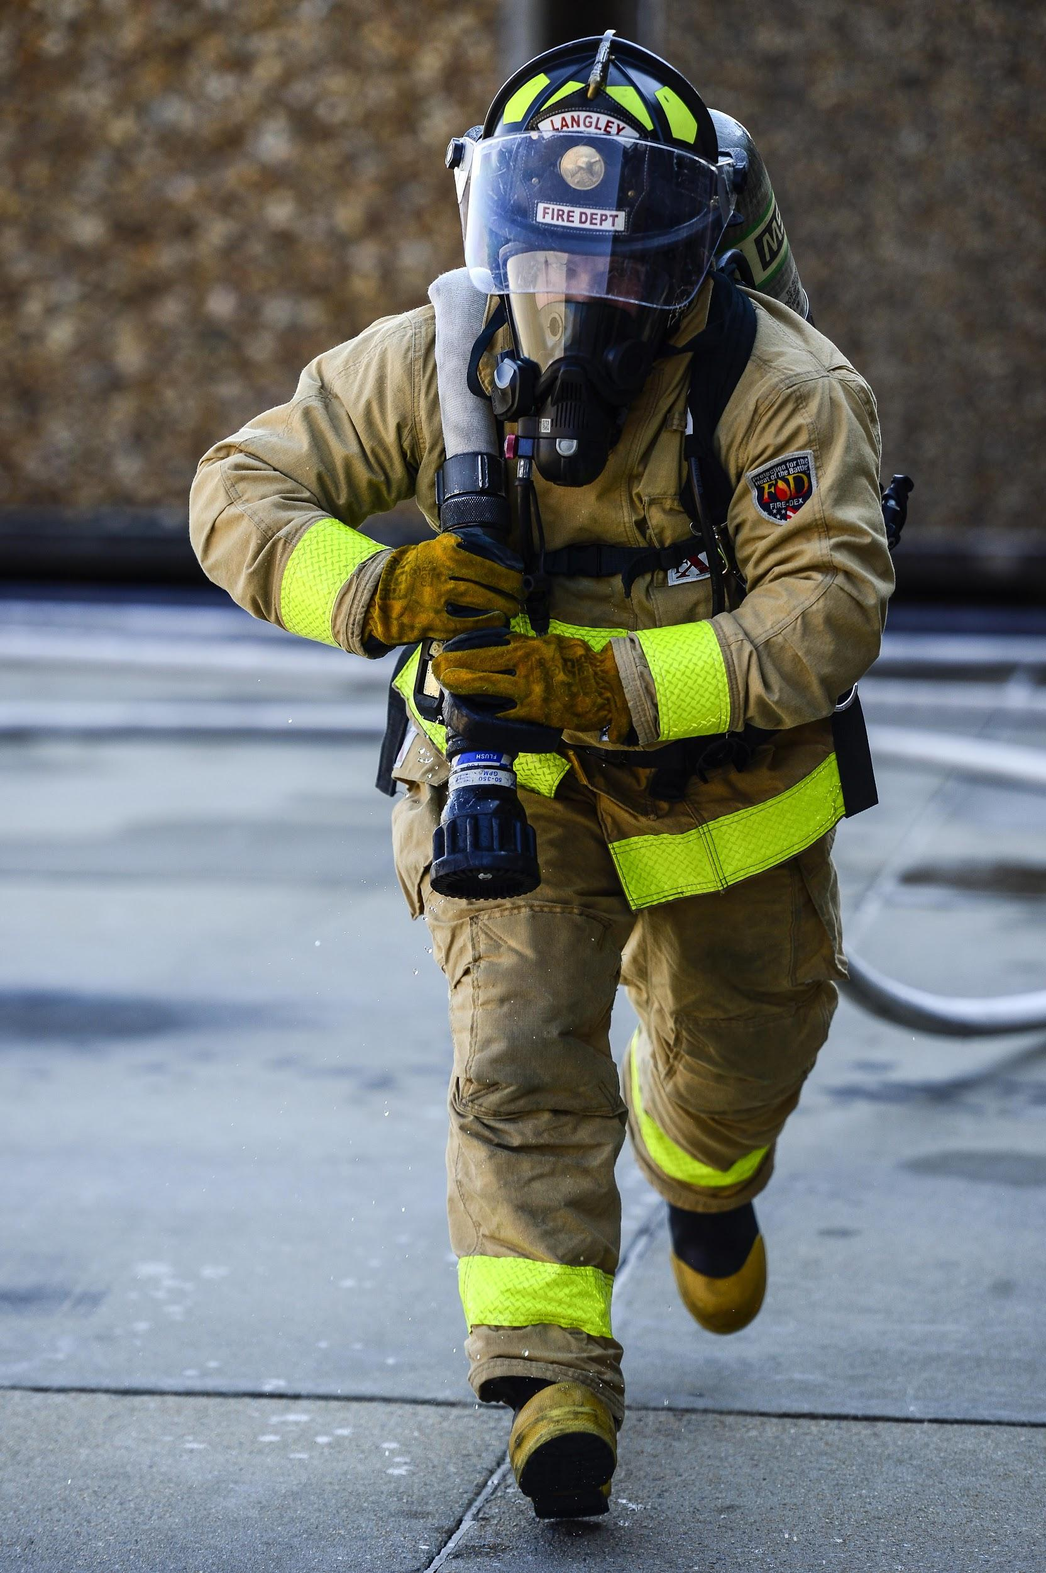
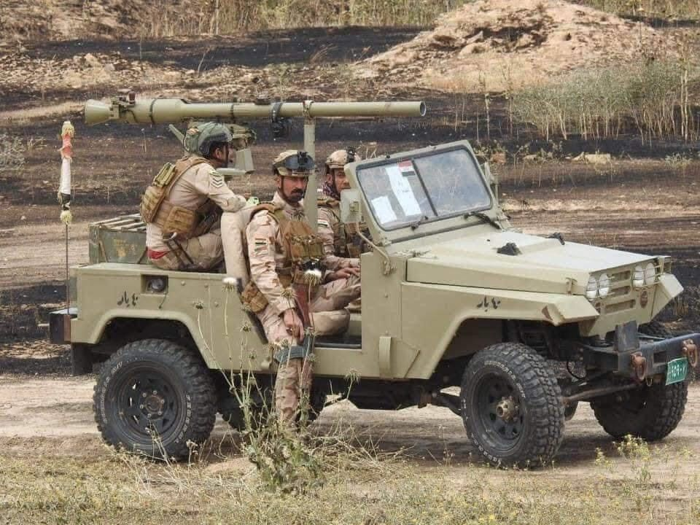
5G Diagram
Image Source: https://www.nec-labs.com/trackio
Notes:
Jina

Slide 6
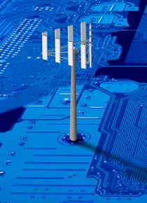
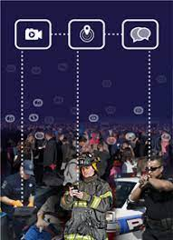
5G Architecture Overview
First Responder Tracker will use the latest technology to assist first responders in dangerous situations. And to do this a 5G network core will need to be employed that can cover the examples seen in the FirstNet architecture. The 5G core is defined by 3GPP and cover 5G functions such as session management and authentication. The 5G core also features network function virtualization which allows for management of network capabilities using software and this can be deployed with multi-access edge computing. Multi-access edge computing can also reduce latency which allow allow first responders to have faster access to important information.
The 5G core will first be deployed as non-standalone and will then shift over to a standalone deployment when available. And when available technology that enables 5G connections via satellites and aircraft will be deployed to allow first responders network access in remote places.
Notes:
Dale
Sources: https://www.viavisolutions.com/en-us/5g-architecture#:~:text=5G%20Core%20Architecture&text=The%20new%205G%20core%2C%20as,of%20traffic%20from%20end%20devices.
https://www.ericsson.com/en/nfv
https://www.verizon.com/business/solutions/5g/edge-computing/multi-access-edge-computing/
Images source and reference: https://www.firstnet.com/resources/knowledge-center/what-is-firstnet.html
https://spectrum.ieee.org/lockheed-martin-5g

Slide 7
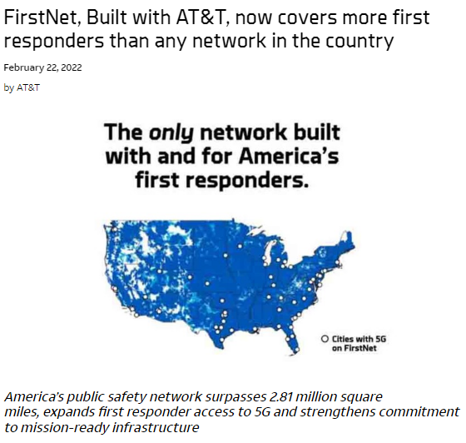
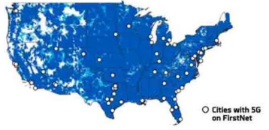
FirstNet 5G Coverage
The First Responder Network Authority is another resource available, it is a dedicated network for first responders. It was established to allow for reliable, fast, secure, around the clock connectivity for communications when cellular networks can become heavily congested in times of emergency [1].
FirstNet is on the LTE commercial and Band 14 spectrum, giving them priority on voice calls, data, and messaging. Videos, photos, texts, and voice calls are shared in near real time with mapping capabilities.
Notes:
Source 1: https://www.firstnet.com/resources/knowledge-center/what-is-firstnet.html
Image Source: https://www.firstnet.com/community/news/firstnet-covering-more-first-responders-than-any-network.html
https://spectrum.ieee.org/lockheed-martin-5g

Slide 8
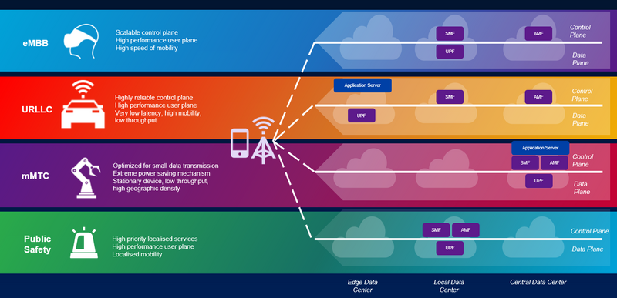
5G Network Slicing
Image Source: https://www.viavisolutions.com/en-us/5g-network-slicing
Notes:
Dale

Slide 9
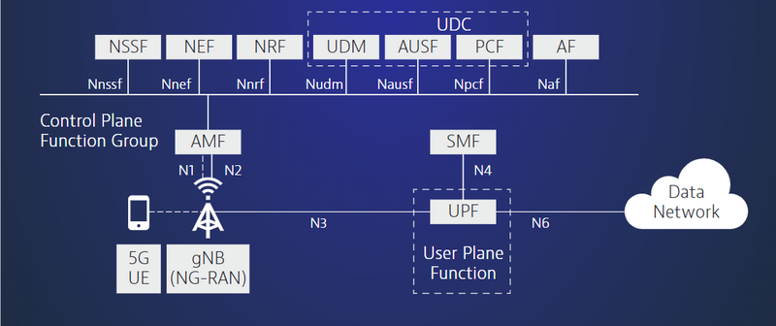
5G Network Core
Image Source: https://www.viavisolutions.com/en-us/5g-architecture#:~:text=5G%20Core%20Architecture&text=The%20new%205G%20core%2C%20as,of%20traffic%20from%20end%20devices.
Notes:
Dale

Slide 10
Our Network
Servers
UE
An example of a network we would like to deploy. Data would go to and from our servers and first responders out in the field.
The range of 5G connectivity can be extended by drones and other means.
Situational data such as the state of first responders inside of a building can be collected by drones outside or inside the building and sent to personal on the ground and then to our servers for processing.
5G Drone
UE
UE
5G Network
5G Drone
UE
UE
UE
UE
UE
Drones
Building
Drone
Drone
Notes:
Dale

Slide 11
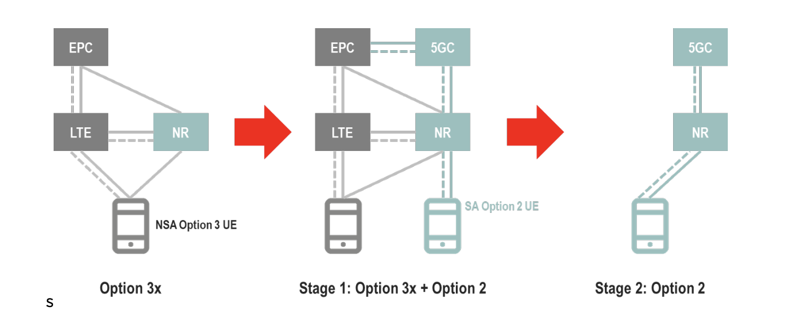
5G Network Deployment Option
The 5G network deployment option that was chosen for our network is option 2. This option is a standalone 5G network and will provide the full potential for 5G. The benefits include low latency, a large amount of bandwidth, and the ability to connect a large amount of Iot devices. This will benefit the First Responder Tracker since the high speeds will allow it to deliver information to first responders in a timely fashion.
Image Source: https://www.gsma.com/futurenetworks/wp-content/uploads/2020/06/5G-SA-Option-2-ImplementationGuideline-v1.3.pdf
Notes:
Dale
Sources:
https://www.gsma.com/futurenetworks/wp-content/uploads/2020/06/5G-SA-Option-2-ImplementationGuideline-v1.3.pdf
https://www.digi.com/blog/post/5g-network-architecture

Slide 12
SIP SDP Call Flow
The figure shown here is a basic SIP SDP call flow for the purposes of establishing communications or multimedia sessions between first responders. These sessions allow for phone calls, video calls, and messaging. We aim to use the SIP protocol with TCP to allow for congestion and flow control and for security by also adding TLS.
UA A
Proxy
UA B
INVITE/SDP
INVITE/SDP
100 Trying
180 Ringing
180 Ringing
200 OK
200 OK
ACK
Media Session
BYE
200 OK
Notes:
Dale

Slide 13
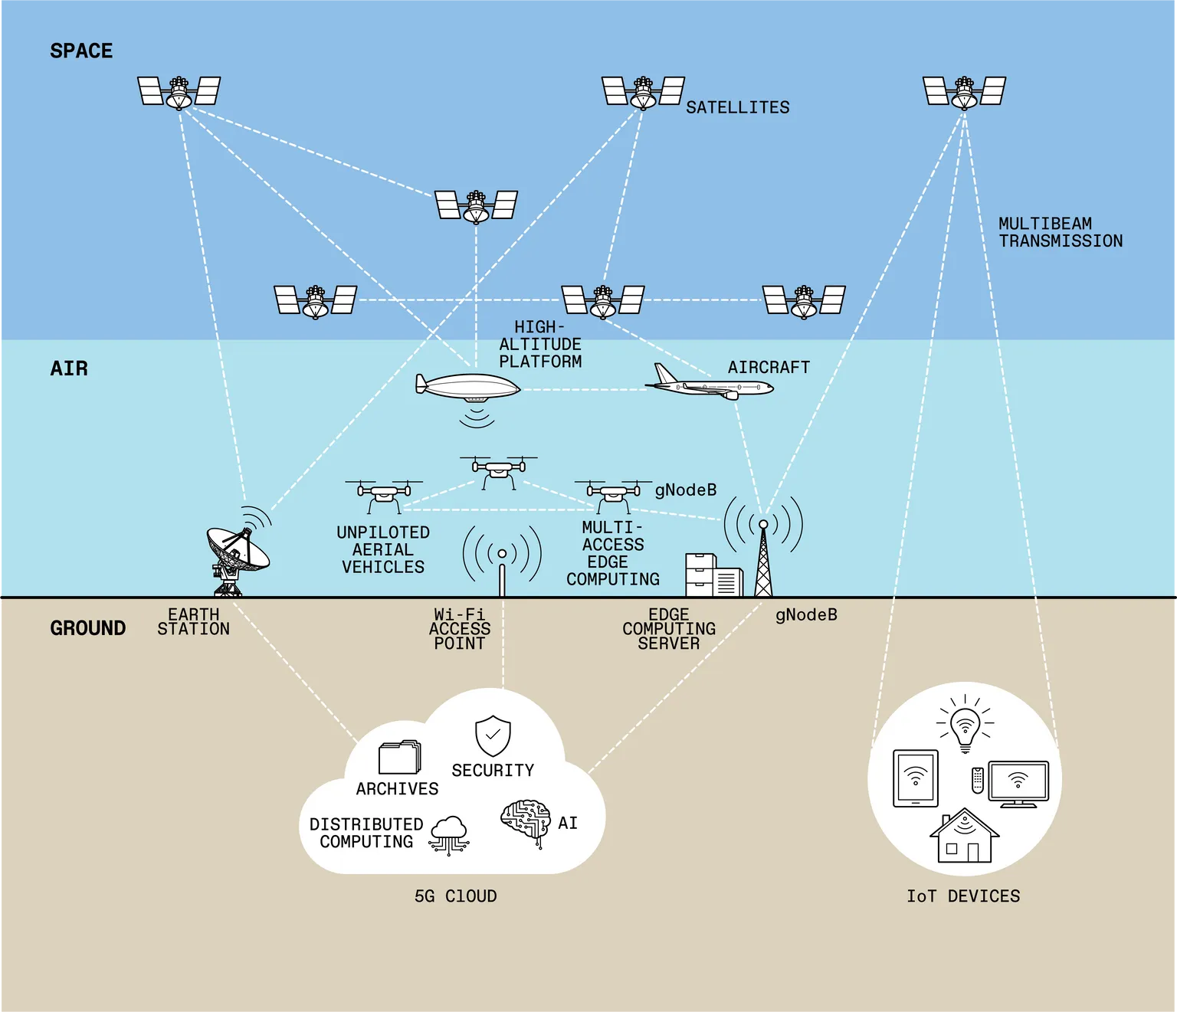
5G With Satellites and Aircraft
Image Source: https://spectrum.ieee.org/lockheed-martin-5g
Notes:
Dale

Slide 14
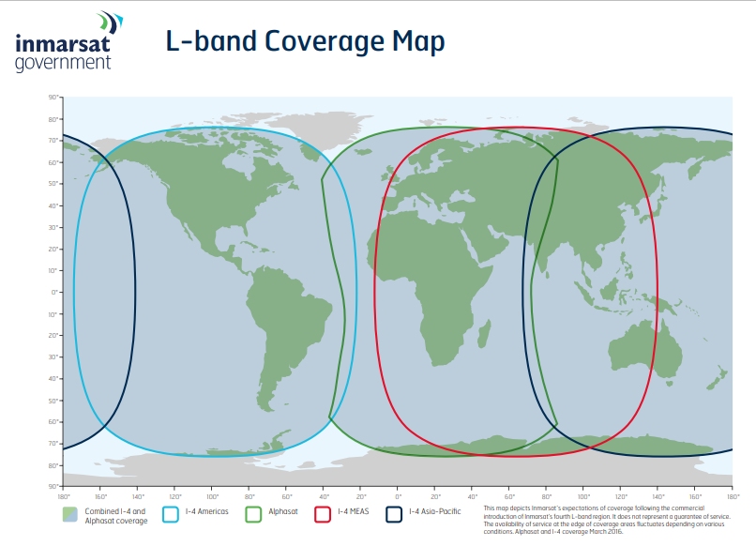
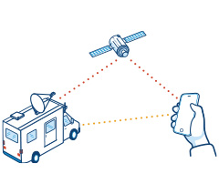
FirstNet Satellite Coverage
In remote and extreme settings, 5G may not be available, especially in combat zones globally. FirstNet has satellite solutions through Inmarsat Government. Satellite phones and transportable
broadband devices expand network capabilities [1].
Inmarsat Government provides satellite communication services to the U.S. government that can reach almost any location on the planet, including remote, wartime, rural, or disaster/emergency-affected areas [2].
Image Source: https://www.inmarsatgov.com/firstnet/wp-content/uploads/2020/03/inmarsat-i4-coverage-map.pdf
Notes:
Jina
Source 1: https://www.firstnet.com/coverage/coverage-enhancements.html
Source 2: https://www.inmarsatgov.com/firstnet/

Slide 15
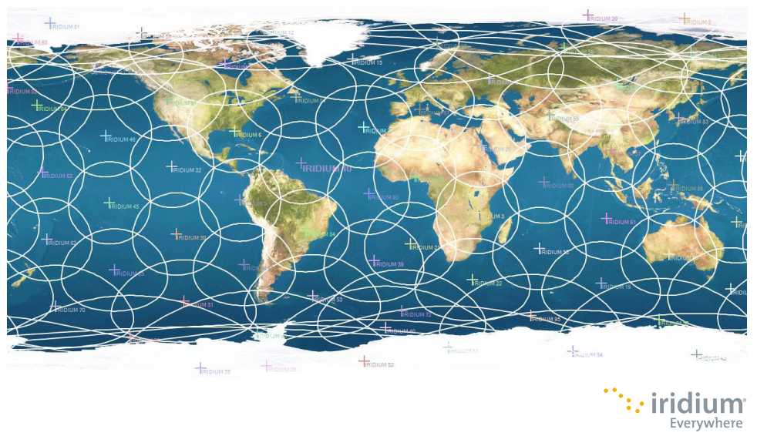
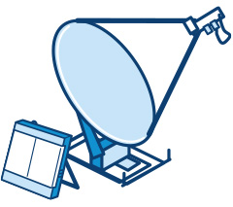
FirstNet Satellite Phone Coverage
When using satellite phones, there is additional latency, however SATCOM services are very easy to use and has global coverage. Inmarsat’s Broadband Gloabal Area Netwrok can be set up in minutes with it’s laptop-siz, portable antennas and can be mounted on platforms including vehibles and boats as the user moves around [1].
Image Source: https://www.inmarsatgov.com/firstnet/wp-content/uploads/2020/03/iridium-coverage-map.pdf
Notes:
Jina
Images and Source 1: https://www.inmarsatgov.com/firstnet/satellite-faq/#coverage
Source 2: https://www.inmarsatgov.com/firstnet/

Slide 16
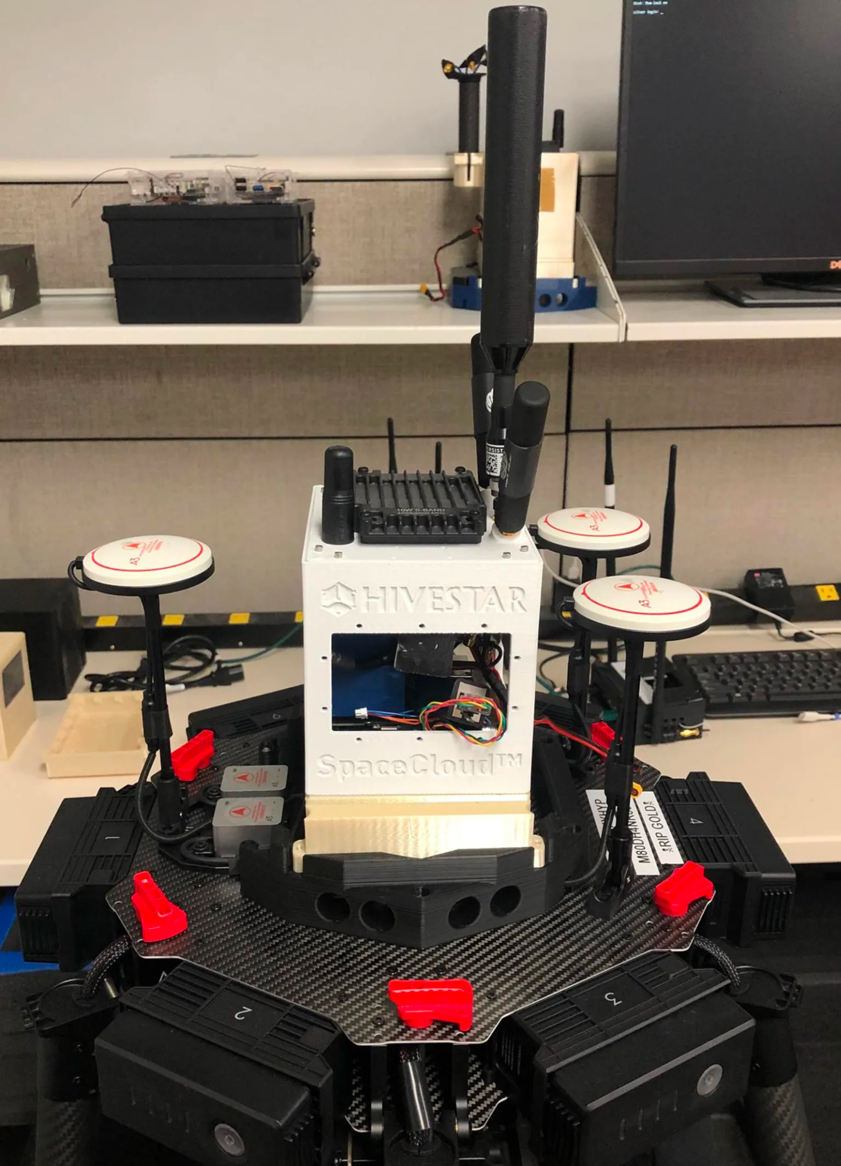
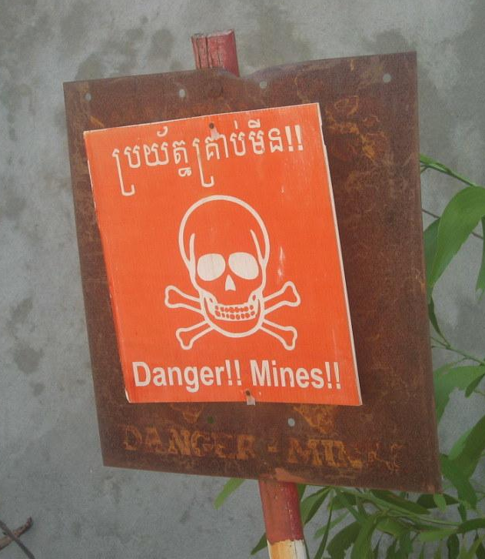
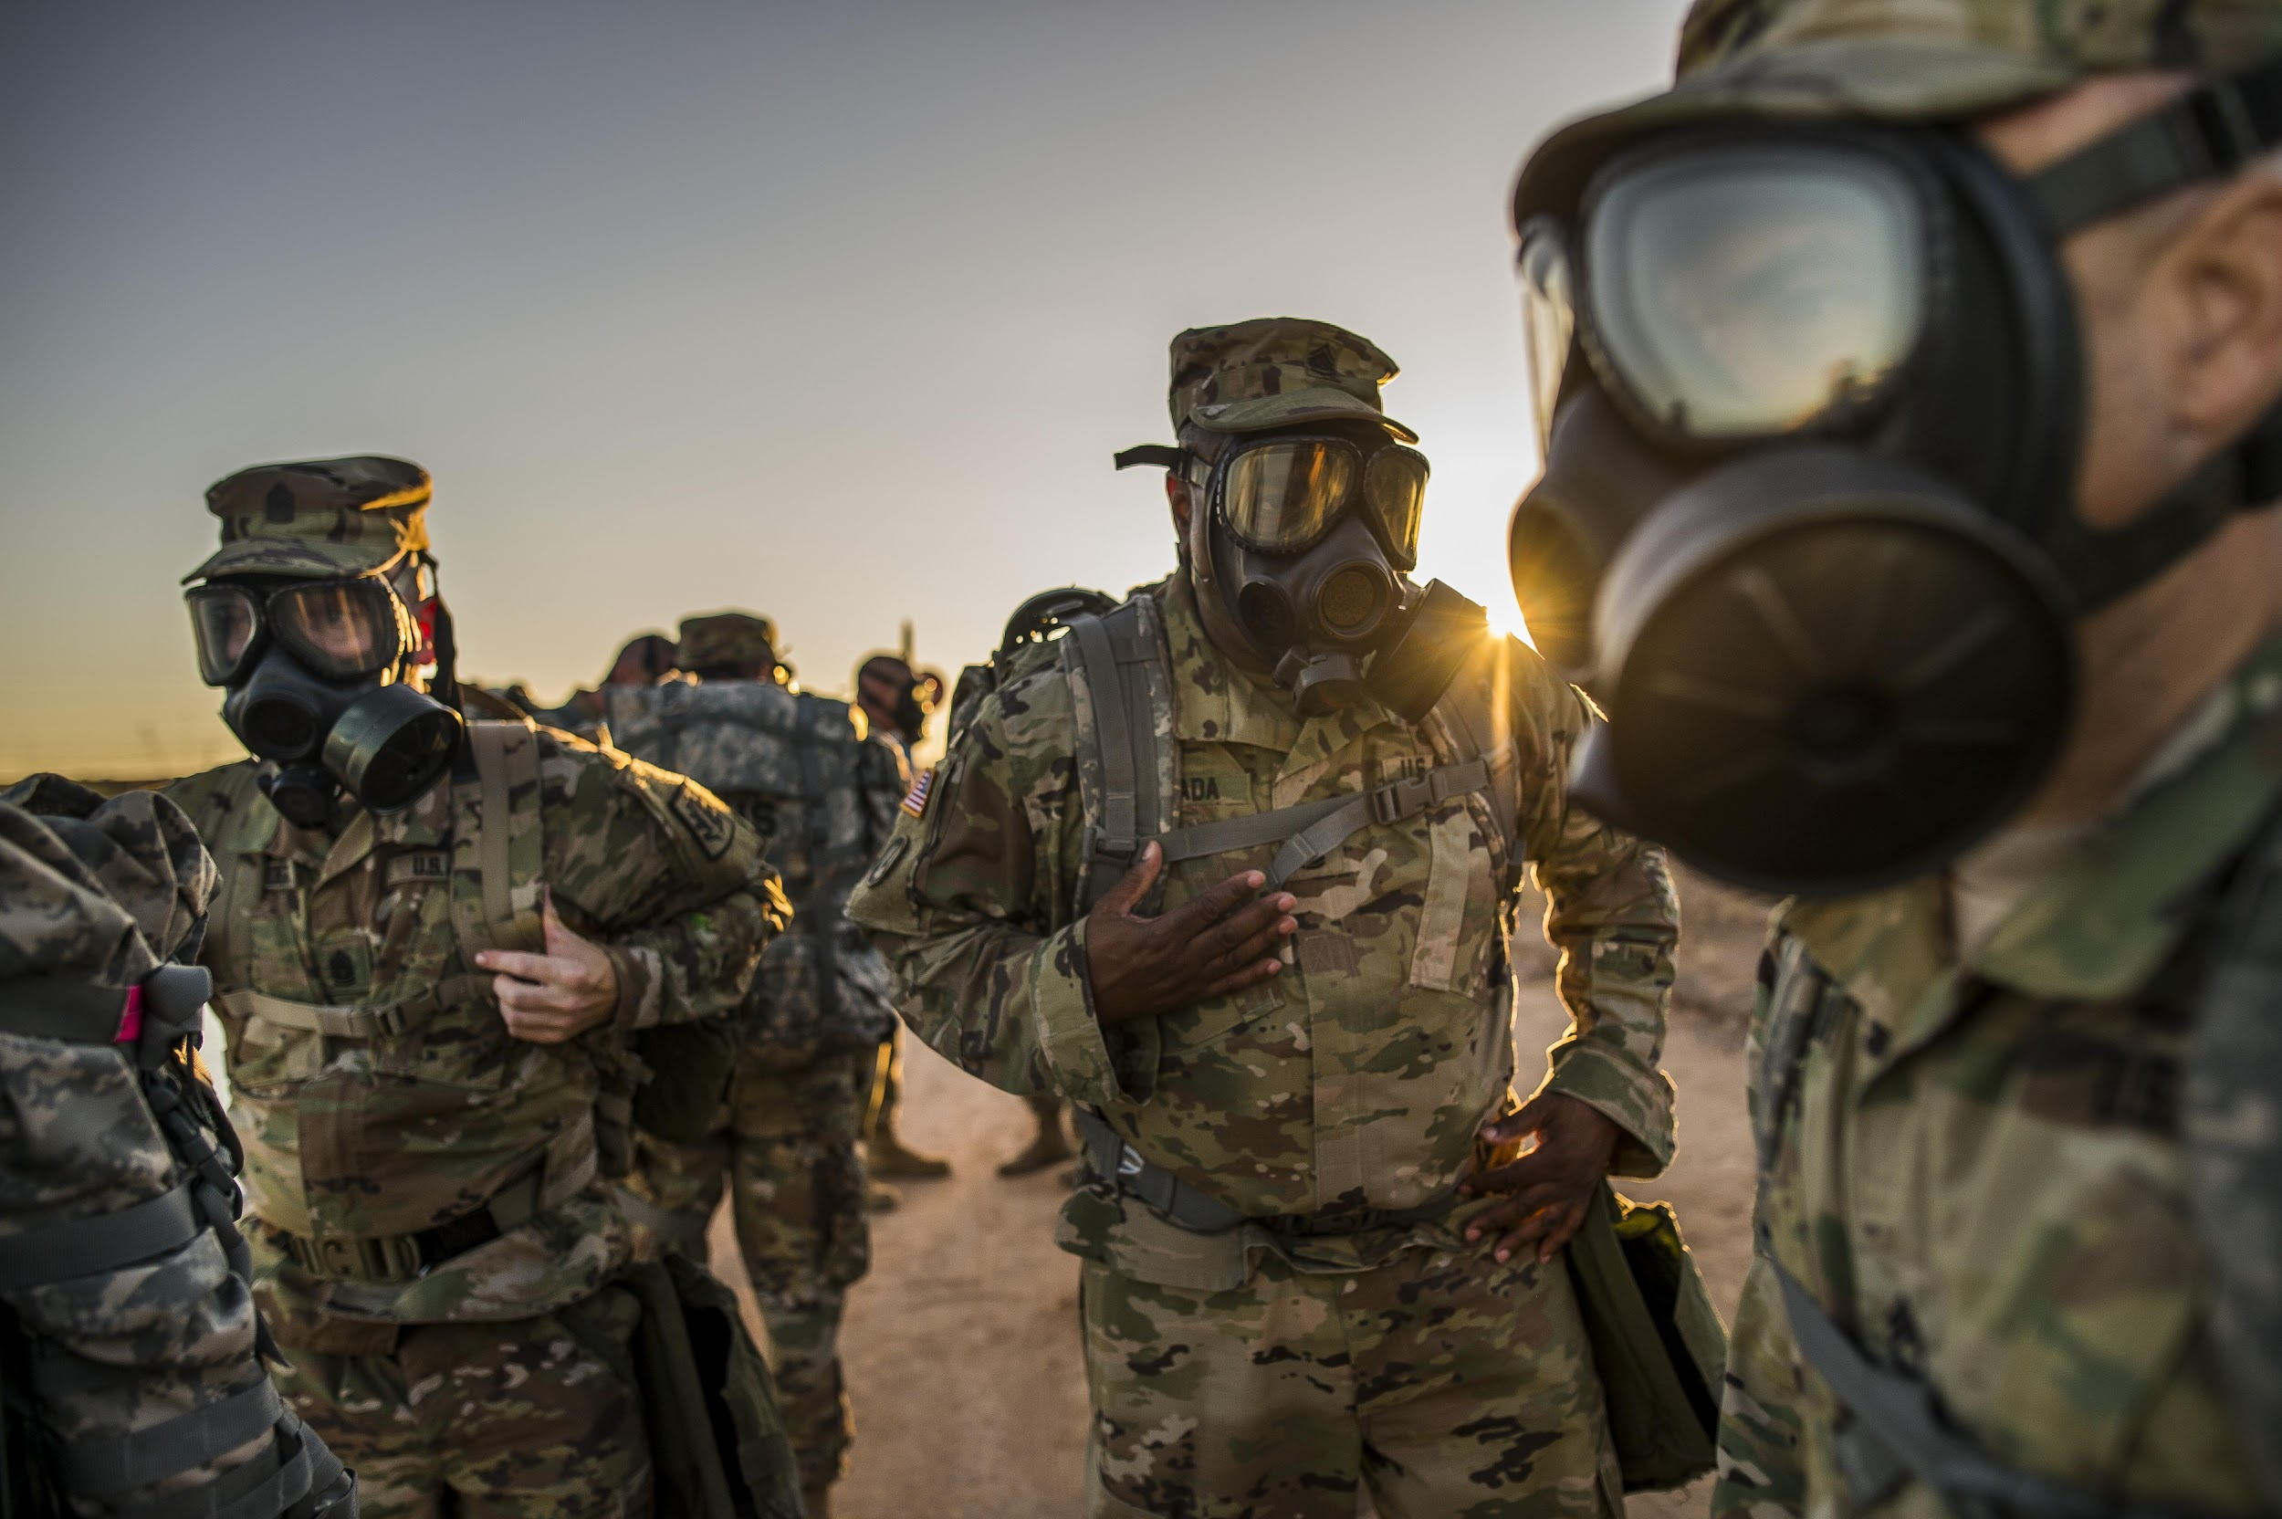
Military and First Responders
First Responder Tracker will use the latest technology to assist first responders in dangerous situations such as on the battlefield, ship-based fires, land mines, extreme temperatures, chemical vapors, indoor and outdoor mapping, and traffic conditions. To aid with this task, the military can deploy various 5G and satellite technologies and sensors to this effect. For instance, sensors can be assigned to individual personnel to monitor their activities and exposure to biochemical hazards on the battlefield. The data collected from this can analyzed and others would be alerted to a potential chemical attack as an example.
For first responders, another technology that can be deployed and would be able to provide 5G coverage in remote areas would be multicopters or drones outfitted with small base stations. These would house small computing devices running distributed computing and communication software would allow for the formation of a 5G network where needed.
Image Source: https://spectrum.ieee.org/lockheed-martin-5g
Notes:
Dale
Sources:
https://spectrum.ieee.org/lockheed-martin-5g

Slide 17
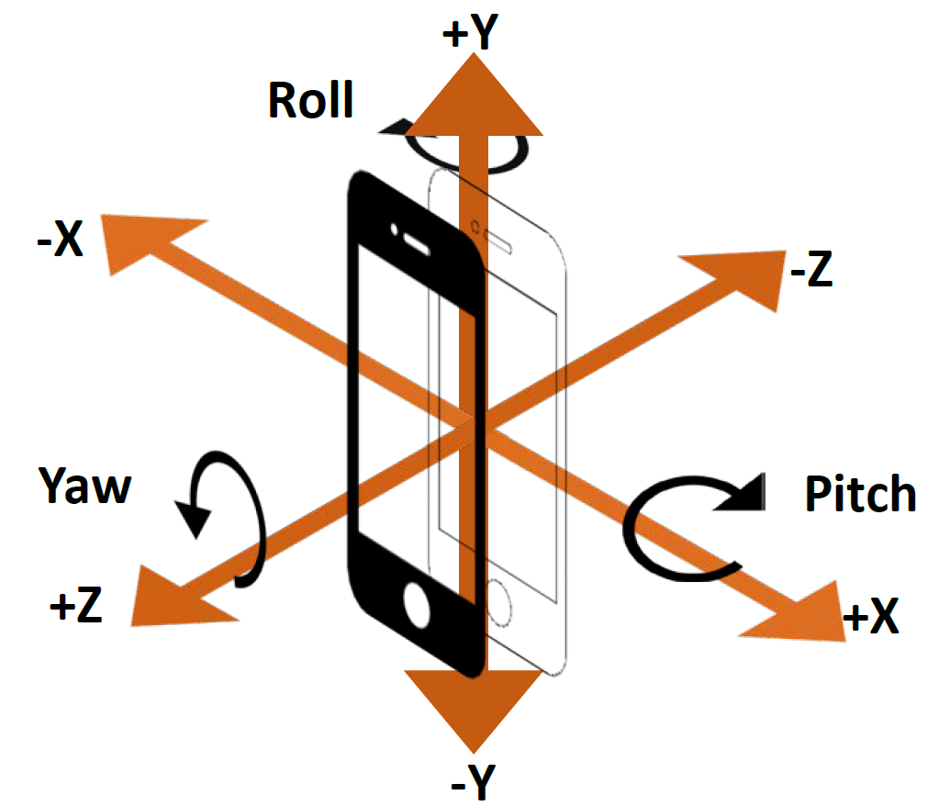
ActivitySensor: Monitoring Activities
The ActivitySensor research helps to address the problems of determining what types activities a person may be engaged in. And they did this using commercially available technologies.
The authors of the paper collected cell phone accelerometer data on individuals and then used the data to train predictive models to perform activity recognition.
This technology and its applications can be used to aid first responders. Since a system that can accurately predict the activities that a person is engaged in can be used to gather information on first responders. As an example, this type of information could be used to see more clearly what is happening to first responders inside of a building.
So by making use of accelerometer sensors, data can be collected on what first responders may be doing or what is happening to them. And by using this data to train predictive models, these model would be able to help determine what issues first responders may be facing. And by making use of 5G technologies this process can be made faster and more accurate.
Image Source: https://blogs.sas.com/content/sgf/2018/09/26/accelerometer-driving-profile/
Notes:
Dale

Slide 18
Land Mine Detection
Another use of the First Responder Tracker technology is sensing and disarming land mines. It is reported that it would take over 500 years to demine the world at the very least.
A drone with GPS, cameras, metal detectors, infrared and hyperspectral imaging, and perhaps a robotic arm attachment may be able to locate and detonate a land mine safely.
5G would help drones with live video feed and transmitting data quickly. Outdoor conditions and the weathering process are very challenging as most land mines are hard to detect after they have been buried for a long period of time, and the algorithms for mining detection are still underdeveloped (Reports). There is a lot of opportunity, however there are also cybersecurity concerns if using 5G in non-U.S. countries to take into account.
Image Source: https://www.theverge.com/2016/7/19/12222104/landmine-detecting-drone-mine-kafon-drone
Notes:
Jina
Source: https://www.rand.org/pubs/monograph_reports/MR1608.html
https://www.theverge.com/2016/7/19/12222104/landmine-detecting-drone-mine-kafon-drone (Image source)
https://sgp.fas.org/crs/natsec/IF11251.pdf security concerns for the military with 5G

Slide 19
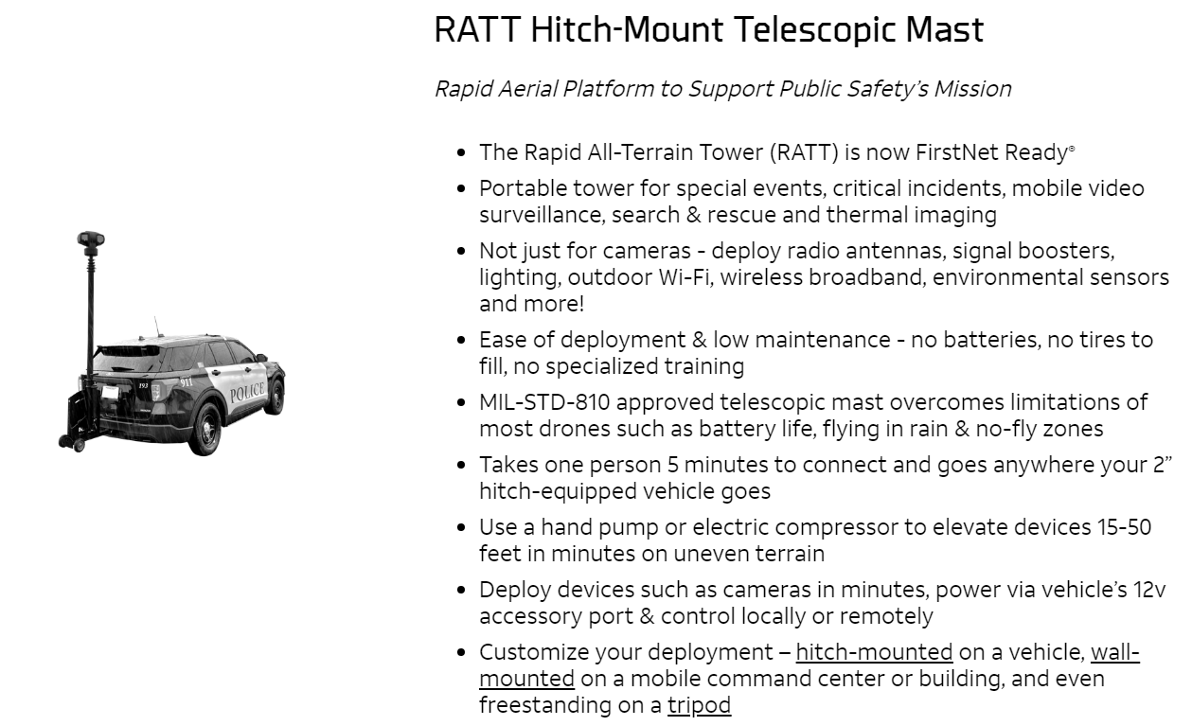
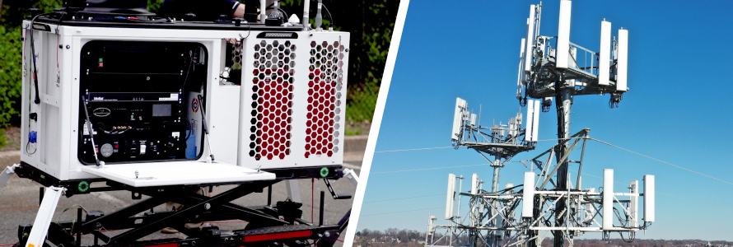
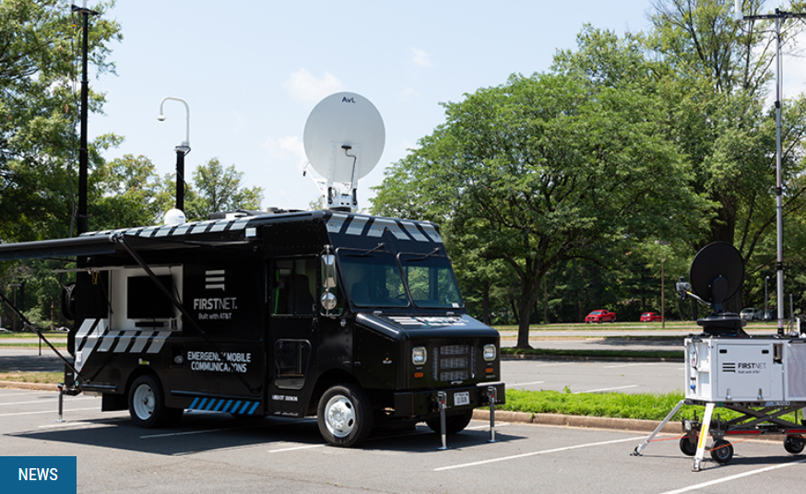
Deployable Connectivity with FirstNet
As of March 2022, there are 150+ FirstNet deployables.
Notes:
Jina
FirstNet RATT image Source: https://www.firstnet.com/industry-solutions/iot/embedded-iot-solutions/ratt-hitch-mount-telescopic-mast.html
FirstNet news image Source: https://urgentcomm.com/2021/06/24/firstnet-includes-new-deployable-types-in-expansion-of-dedicated-fleet/

Slide 20
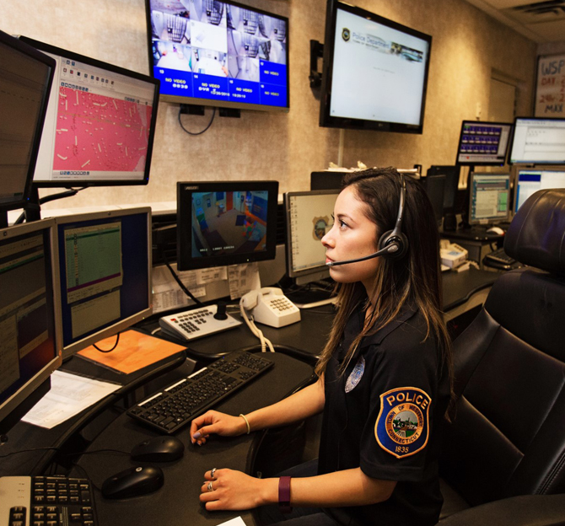
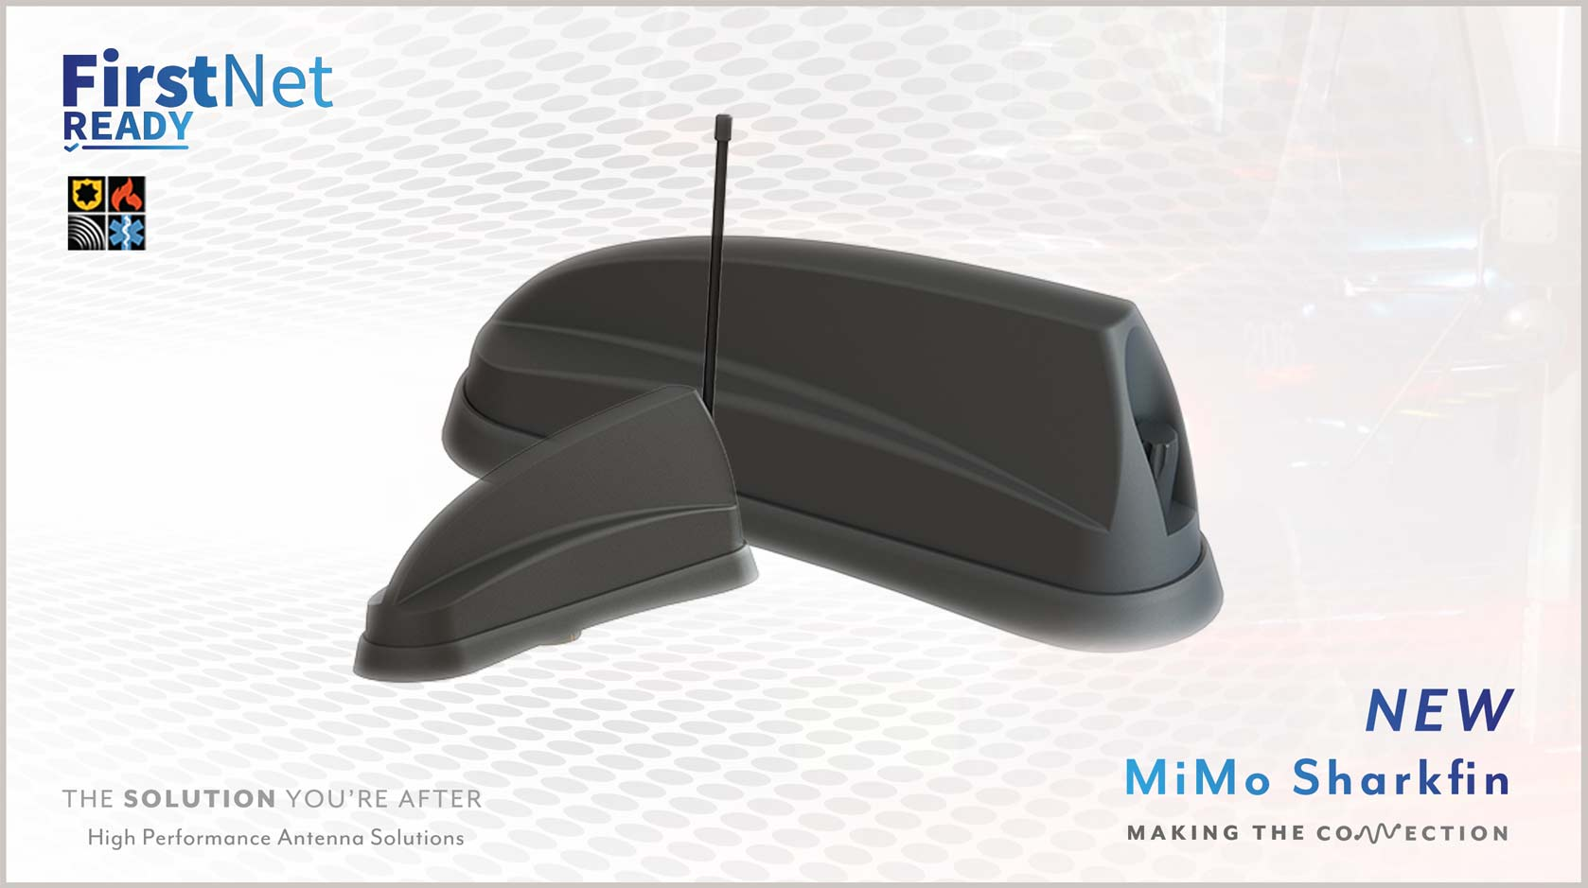
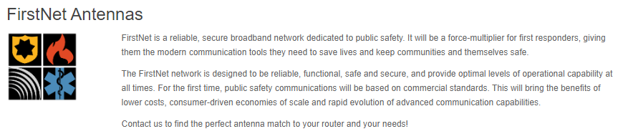
FirstNet In-Building Solutions
For those on the FirstNet network, Distributed Antenna Systems (DAS) is used where large concrete and steel structures limit indoor cellular coverage.
The DAS network has over 6,000 networks of small antennas that enhance wireless services that network services typically do not reach.
Source: https://www.firstnet.com/coverage/coverage-enhancements.html
Source: https://www.panorama-antennas.com/FirstNet-Antenna
Source: https://www.panorama-antennas.com/site/Mobile-Radio/FirstNet
Notes:
Jina
FirstNet Antennas Source: https://www.panorama-antennas.com/site/Mobile-Radio/FirstNet

Slide 21
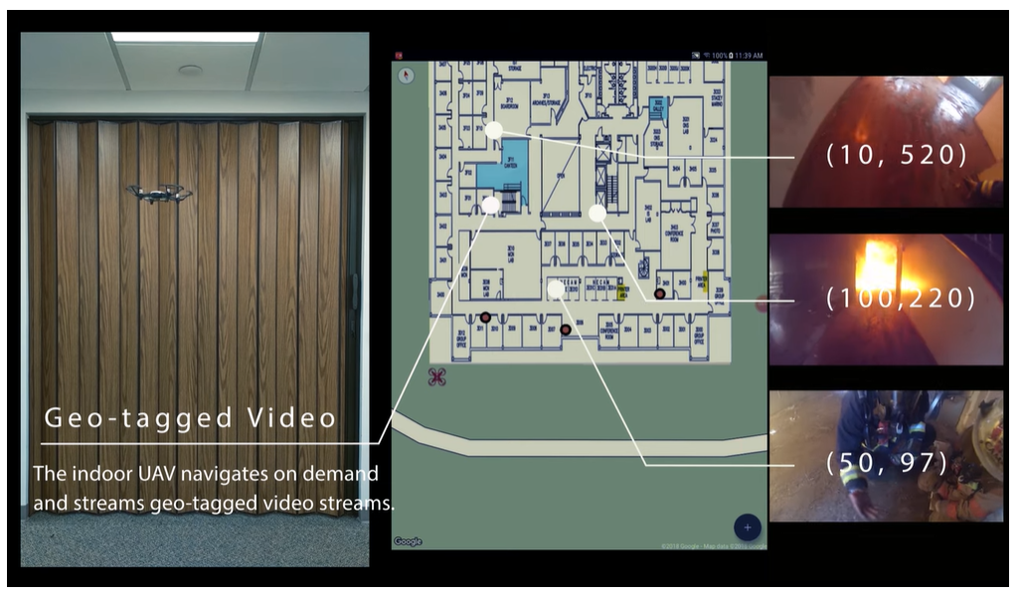
Indoor Mapping with Geo-Tagging
Without FirstNet systems, indoor mapping is still very difficult. Ultra-wideband (UWB) radio technology has shown the best results so far for creating maps indoors. Smartphones are starting to support UWB. Research has shown that geo-tagging of several points using indoor Unmanned Aerial Vehicles (UAV aka drones) with innovative algorithms to accurately track first responders is possible.
The image on the left shows a drone exploring inside of a building and passing along the GPS coordinates. These coordinates can also be taken from devices carried with the first responders.
TrackIO Demo Video Screenshots from https://www.nec-labs.com/trackio
Notes:
Jina

Slide 22
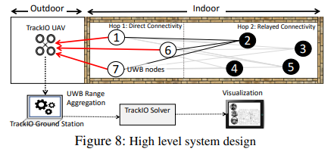
Indoor Mapping with Geo-Tagging
The diagram in Figure 8 is a high-level view of experimental research of the node tracking algorithm and system design with the UWB devices for creating tracking/mapping data. Outdoor cellular or wi-fi signals were needed in order to create indoor mapping infrastructure. With that connectivity, geo-tagging can send location coordinates with video data of the first responder’s environment in real-time from indoors.
Notes:
Jina

Slide 23
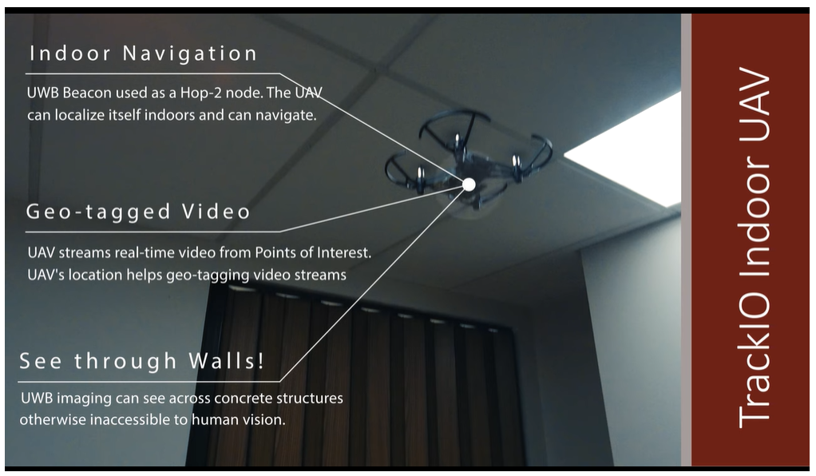
Indoor Mapping and Sensing Research
TrackIO Demo Video Screenshots from https://www.nec-labs.com/trackio
Notes:
Jina

Slide 24
Indoor Mapping and Sensing Research (cont.)
TrackIO Demo Video Screenshots from https://www.nec-labs.com/trackio
Notes:
Jina

Slide 25
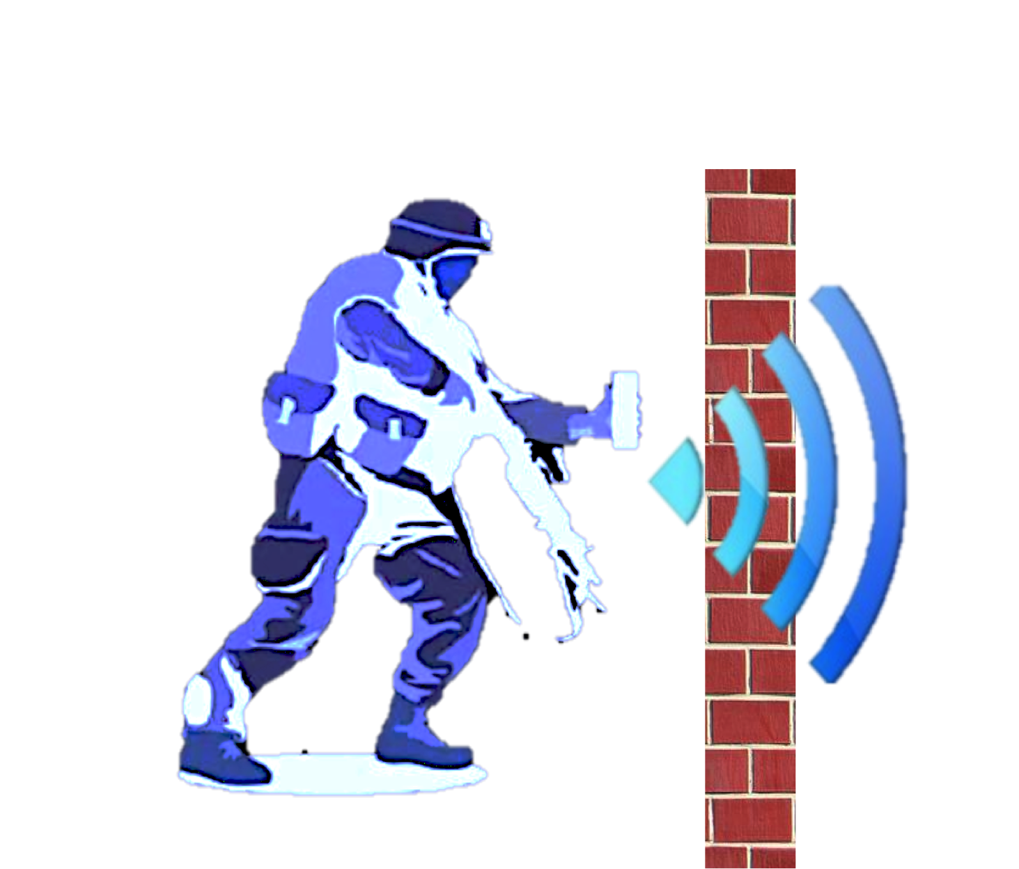
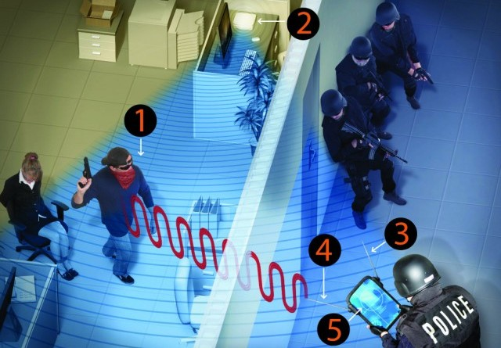
Wi-Vi Technology
By using Wi-Fi signals and with MIMO communications we can build Wi-Vi which can capture motions of humans behind a wall or closed rooms.
What is Wi-Vi?
-> Wi-Vi is a wireless device that captures moving objects behind a wall using low power Wi-Fi signals
-> This technique uses reflected Wi-Fi signals to track movements of people behind the wall.
Notes:
Raisul

Slide 26
How does Wi-Vi work?
Wi-Vi is effectively a three-radar device that uses MIMO interface, with double antennas, one for transmitting the data and the other one for receiving. Another antenna called directional antenna is used to send the energy at the desired area or wall or room.
Its design consists of two key elements:
a. By performing MIMO nulling, the first element reduces the flash reflected off the wall.
b. The second element follows a moving object by considering the item as an antenna array using an inverse ISAR approach.
Existing antenna array systems catch the signal reflected off a target from regionally dispersed antennas and analyzed it to determine the target’s orientation in relation to the array.
Inverse Synthetic Aperture Radar (ISAR) has only one receiving antenna. Therefore the receiver only takes a single measurement at any moment
When the object travels, it reacts as the signal is received at different positions, as if each of these sites had
a receiving antenna.
Wi-Vi receives sequential time samples that match to consecutive three-dimensional positions of the moving object
due to channel interchange. Therefore, Wi-Vi practically gets whatever an antenna array receives in space in real time.
Notes:
Raisul

Slide 27
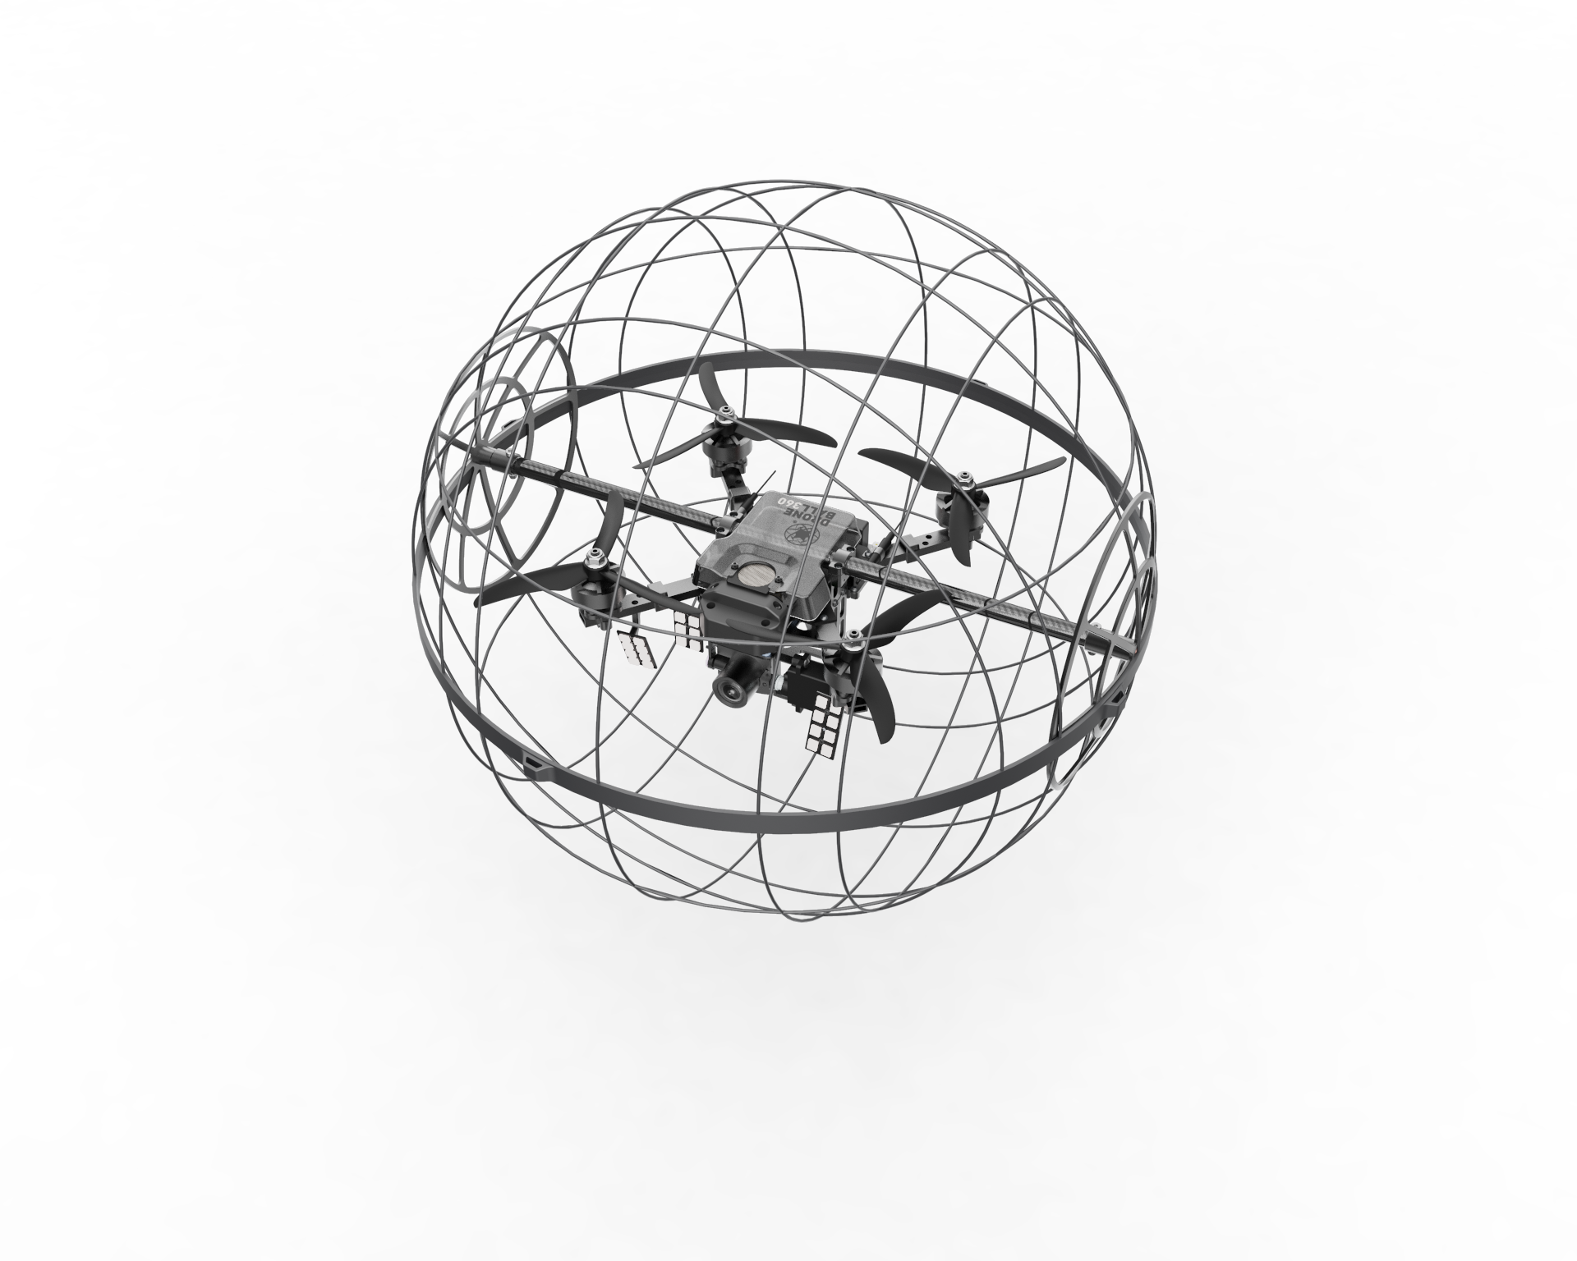
Indoor Drone
5G mini UAV drones with UnLoc sensory signatures, thermal sensors, and electrochemical sensors along with a combined array of sensors including gyros, magnetometers and accelerometers with a GPS, flight control CPUs are able to use the data on the attitude, velocity, position and heading of the UAV to direct the flight and operation of the drone according to the parameters.
Once released the drones will provide the layout inside the building including thermal view, the amount of smoke, chemical vapors, and temperature.
The high volume of data will be analyzed in real-time and processed for immediate viewing on the GUI.

Slide 28
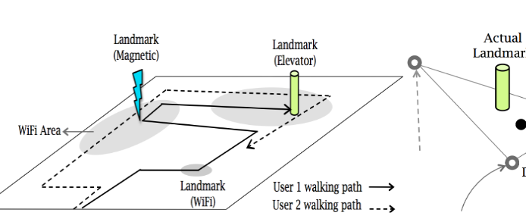
Indoor Drone Sensors
UnLoc sensors: Wi-Fi and magnetic fluctuations for use as landmarks to create an indoor layout of the building
Drone can listen to one set of Wi-Fi hotspots and a particular point may experience unusual magnetic fluctuations microphones and magnetometers can detect ambient sounds and magnetic vibrations.
The signatures may reside in a magnetic region where metals at a particular location can produce unique and reproducible vibrations on a drone’s magnetometer near that location
These signatures are considered as internal building landmarks. The landmarks are, in fact, some structures in the building, stairs, elevators, entrances that behave in a predictable way. This predictable behavior can be translated into sensor signatures
Drones detecting these landmarks can recalibrate their position, and then can track them between landmarks. The system simultaneously calculates drone’s positions and landmarks.
Notes:
Samantha

Slide 29
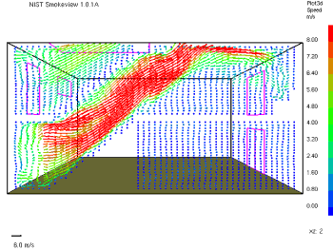
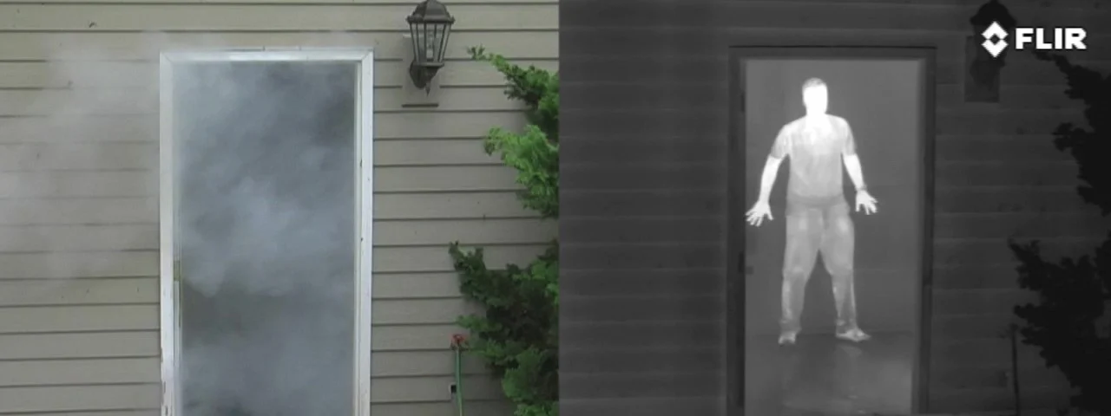
Indoor Drone Sensors
Thermal sensors: Provide the thermal imaging and infrared radiation to see through smoke.
Electrochemical sensors: Detects gases such as carbon monoxide, nitrogen dioxide, hydrogen sulfide, sulfur dioxide, and ammonia.
Notes:
Samantha

Slide 30
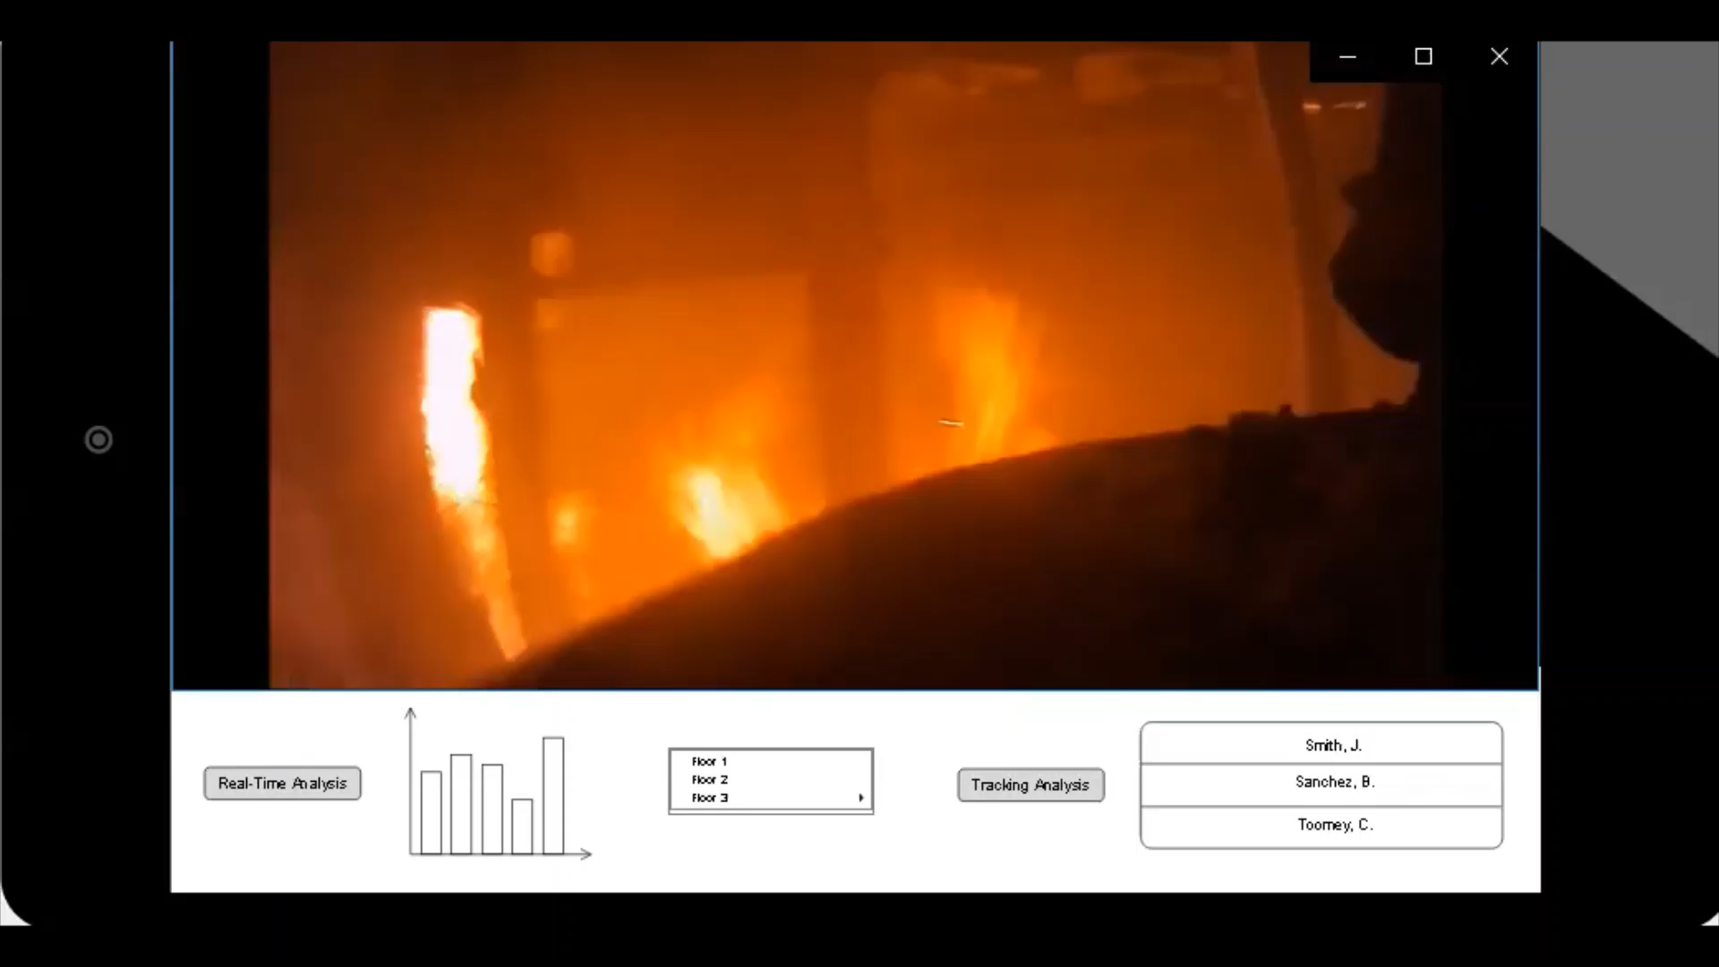
First Responder Tracker GUI
https://youtu.be/kmizSvZMxwA
Notes:
Samantha

Slide 31

Future Work
Enable 5G connections by satellites and aircraft to allow access in remote areas.
Move to a stand alone 5G architecture.
Employ 6G technologies for even faster connections, data processing and reduced latency.
Notes:
Dale,

Slide 32




Conclusion
The First Responder Tracker system will allow emergency personnel to safely gather real-time information to assess and assist their responses to dangerous situations using 5G technologies. This will help to improve outcomes for first responders and save lives.

